Slide 1
Welcome to a visual story documenting some of the Mtaala Foundation’s work with Awegys Secondary School over the years in Kigo, Uganda.
1.2018

Slide 2
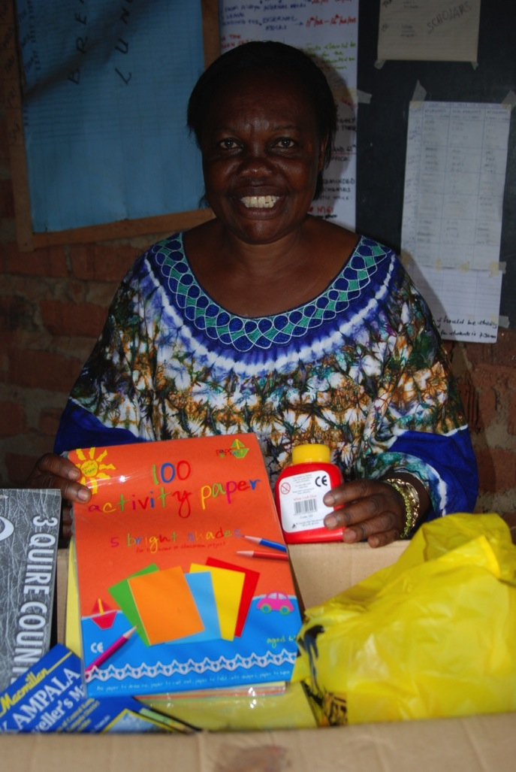
Alice Wegoye, a retired school teacher and mother of ten, was moved to help Uganda’s orphans and children affected by war and extreme poverty.
She gave up her house and land, turned her home into a dorm, and used her tiny pension to begin construction of Awegys Secondary School in
the village of Kigo, Uganda.
Here, Alice displays school supplies donated by an Mtaala supporter.

Slide 3
Inspired by Alice’s vision, dedication, and sacrifice, in 2008 the Mtaala Foundation forged an educational partnership with Alice’s school,
Awegys Secondary School in Kigo, Uganda.

Slide 4
This school would welcome children who dreamed of attending school but—due to extreme poverty, war, or the death of their parents—
could not afford school.

Slide 5
Mtaala would help make it happen.

Slide 6
The school’s beginning…

Slide 7
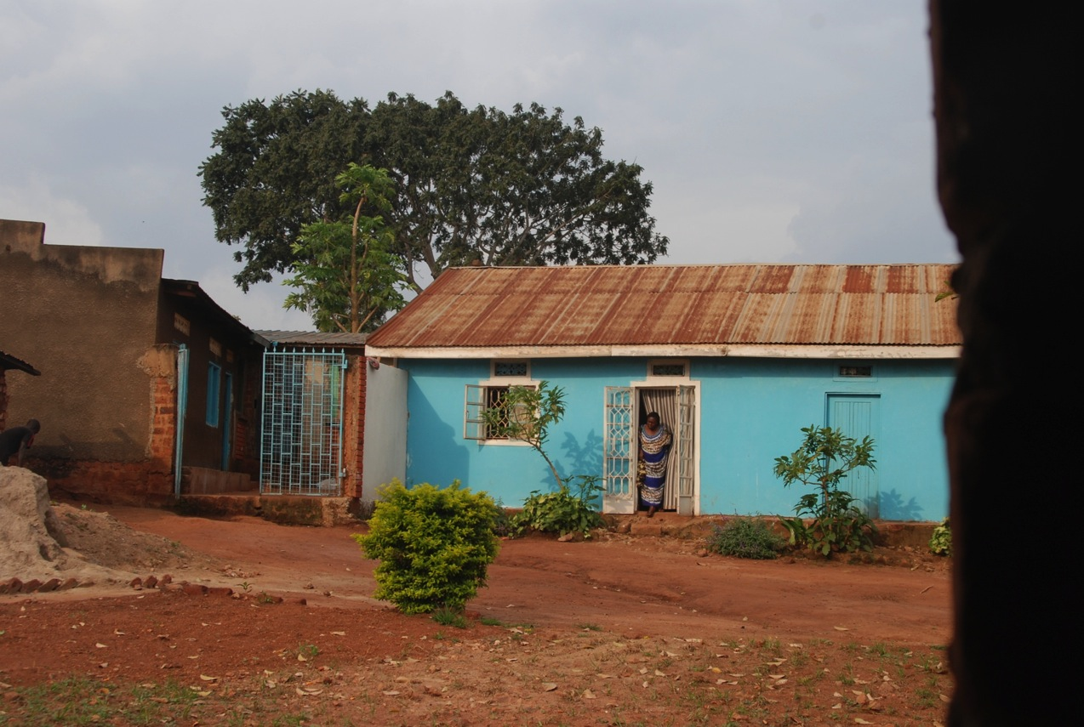
A view through a classroom window of Alice looking
out of what was her house—but is now the girls’ dorm.

Slide 8
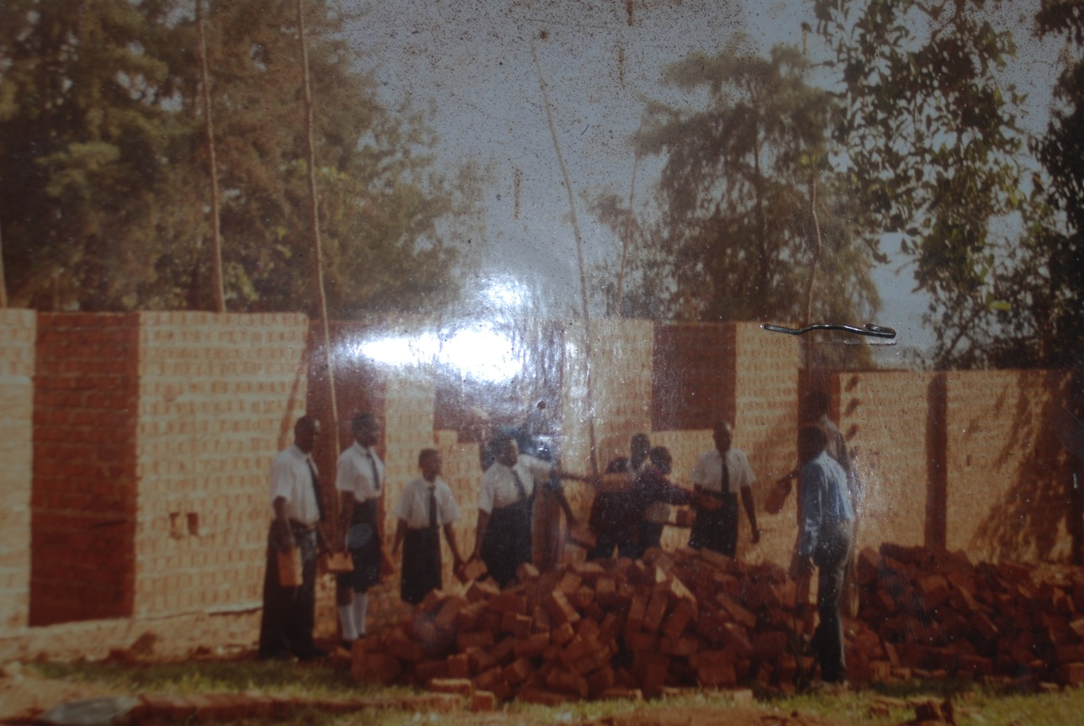
ut
Students help move a delivery of new
bricks for the first classroom block .

Slide 9
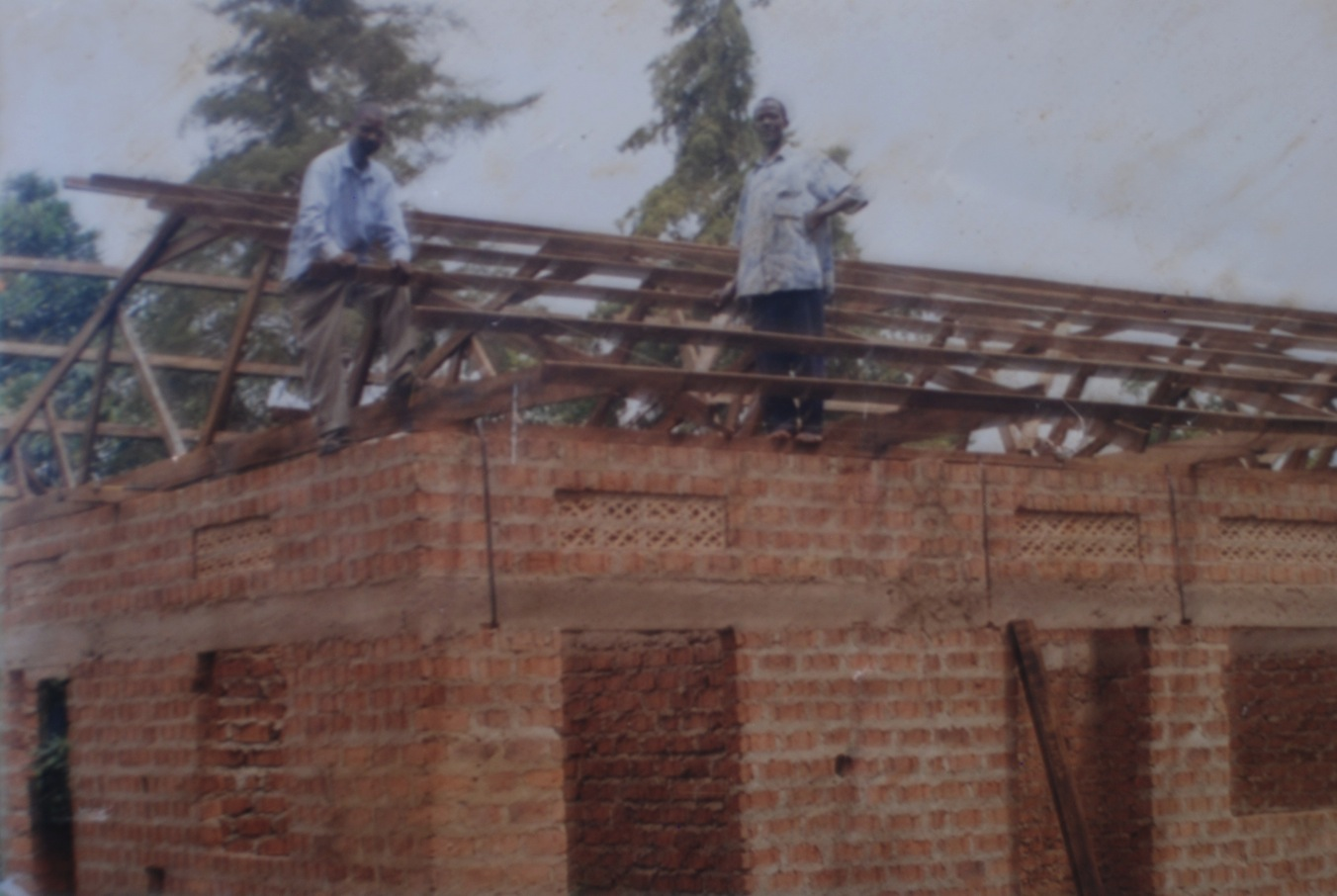
An initial donation from Mtaala was used to install a roof on the first classroom block.

Slide 10
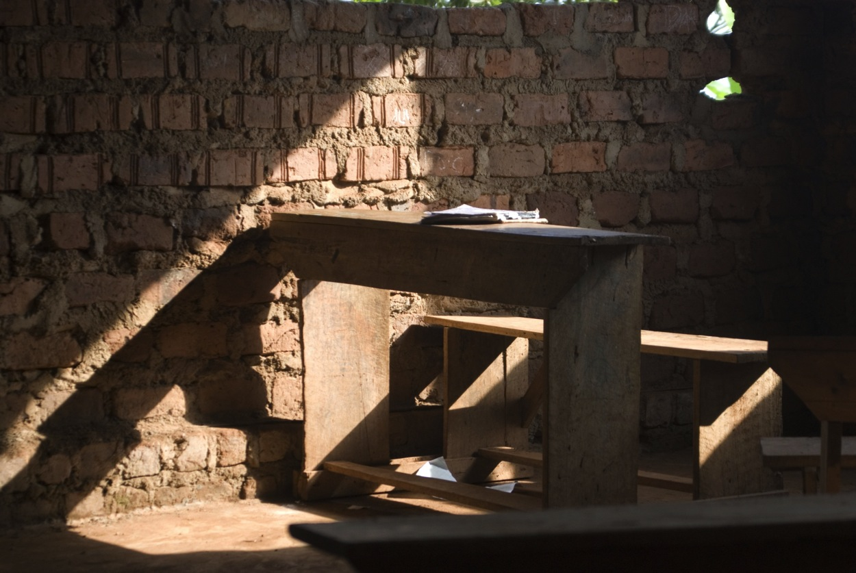
h
A desk sits in the sunlight
of an Awegys classroom.

Slide 11
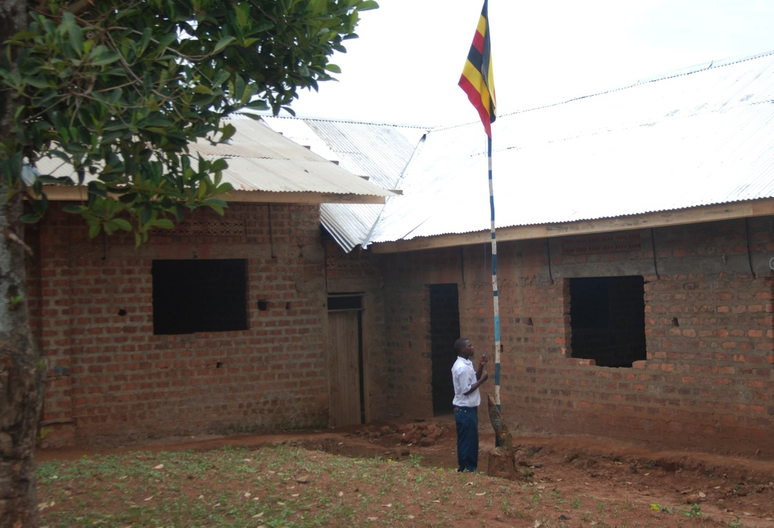
A student raises the Ugandan flag in front of the first finished classroom block—new roof and all!

Slide 12
Once the school had a roof, a classroom, and simple desks, we worked with Ugandan volunteers, particularly in the war-affected
North, to identify students in extreme need.

Slide 13
Students like…
These students would need sponsors to help fund their education.

Slide 14
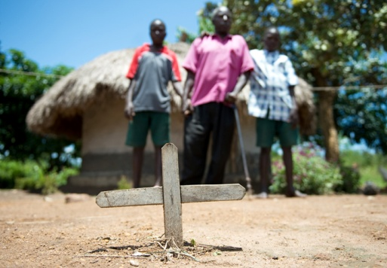
©Amy Mullarkey
Cypriano, who stands behind his mother’s grave and in front of his humble home.

Slide 15
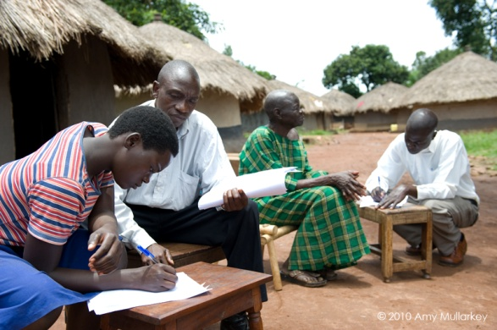
Winifred and her family, residents of an IDP
(refugee) camp, review requirements for admittance
to Awegys, Mtaala’s partner school.

Slide 16
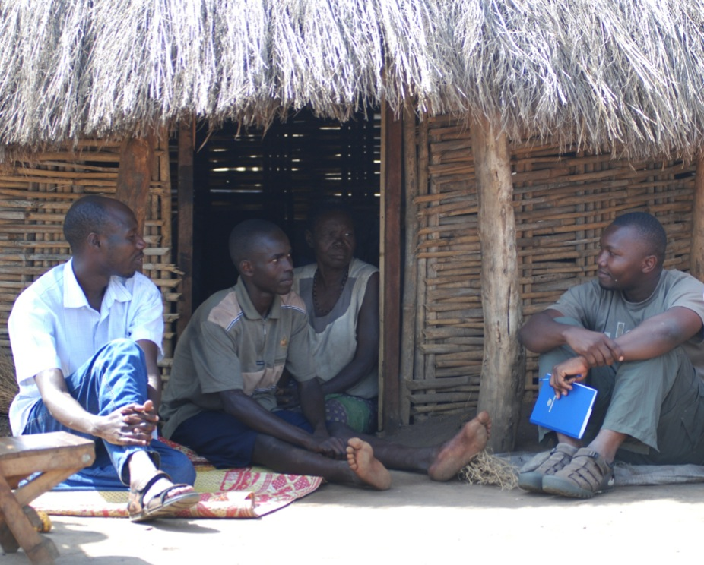
Jimmy, an orphan and former child soldier who lives
with his Grandma at an IDP camp in the north, learns he
has a sponsor who will help fund his education.

Slide 17
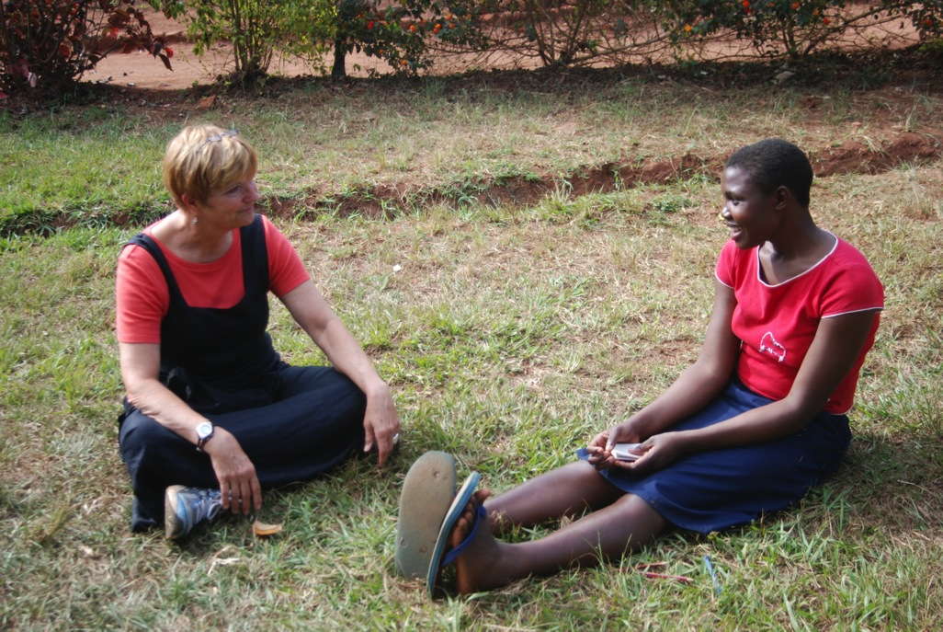
Sponsors are the heart of our program.
They provide the means for students to attend school.
A sponsor visits her sponsored student.

Slide 18
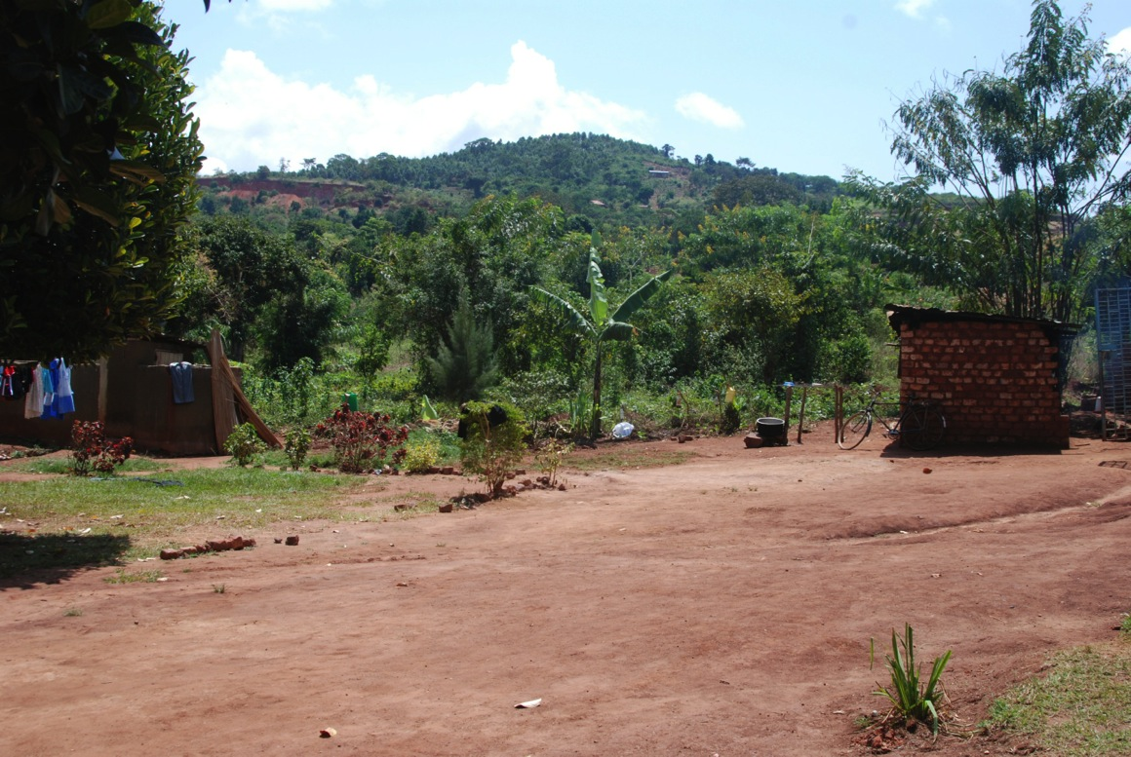
A view up the hill from the school in 2008.
The kitchen is on the right and the latrine is on the left.

Slide 19
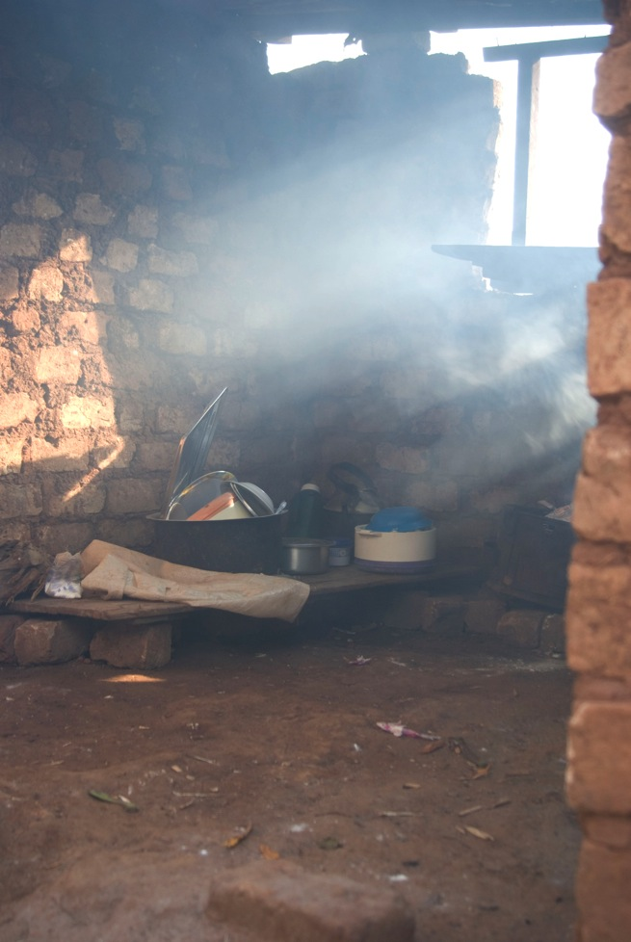
The school
kitchen where
all meals are
prepared over
an open fire.

Slide 20
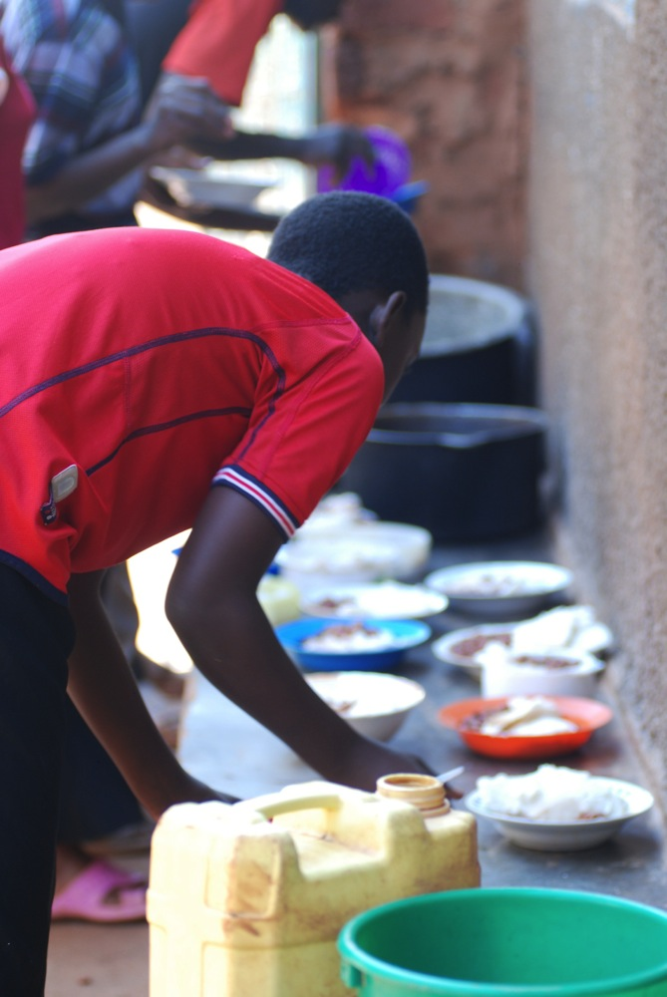
Students line up
for their daily
school lunch of
Posho and beans.

Slide 21
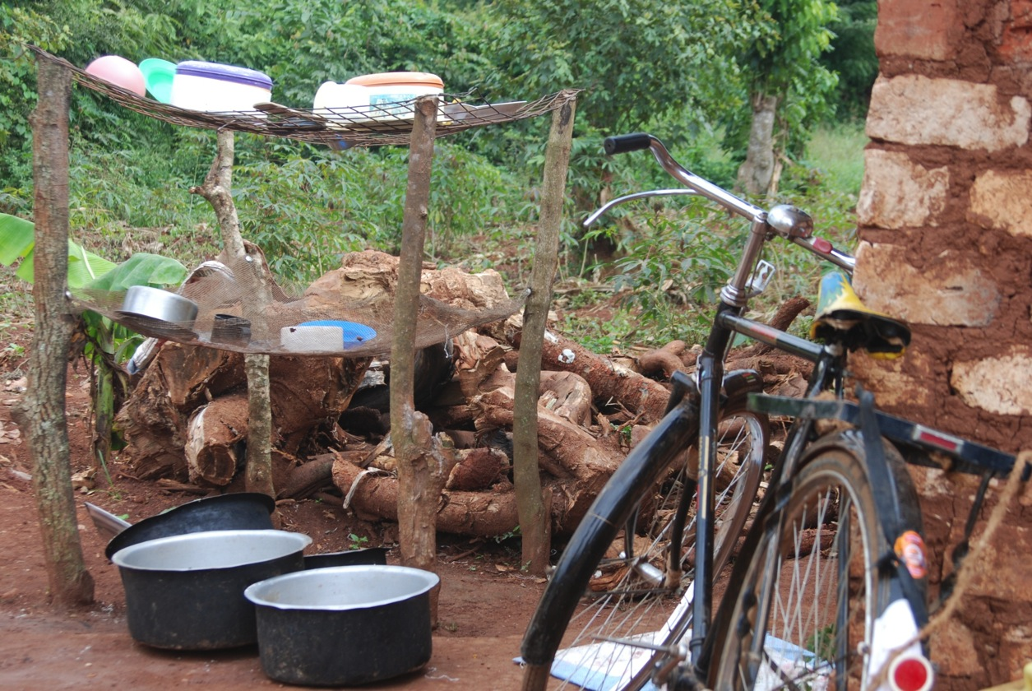
After students wash their dishes, the dishes dry on
a rack next to a stack of firewood by the school’s kitchen.

Slide 22
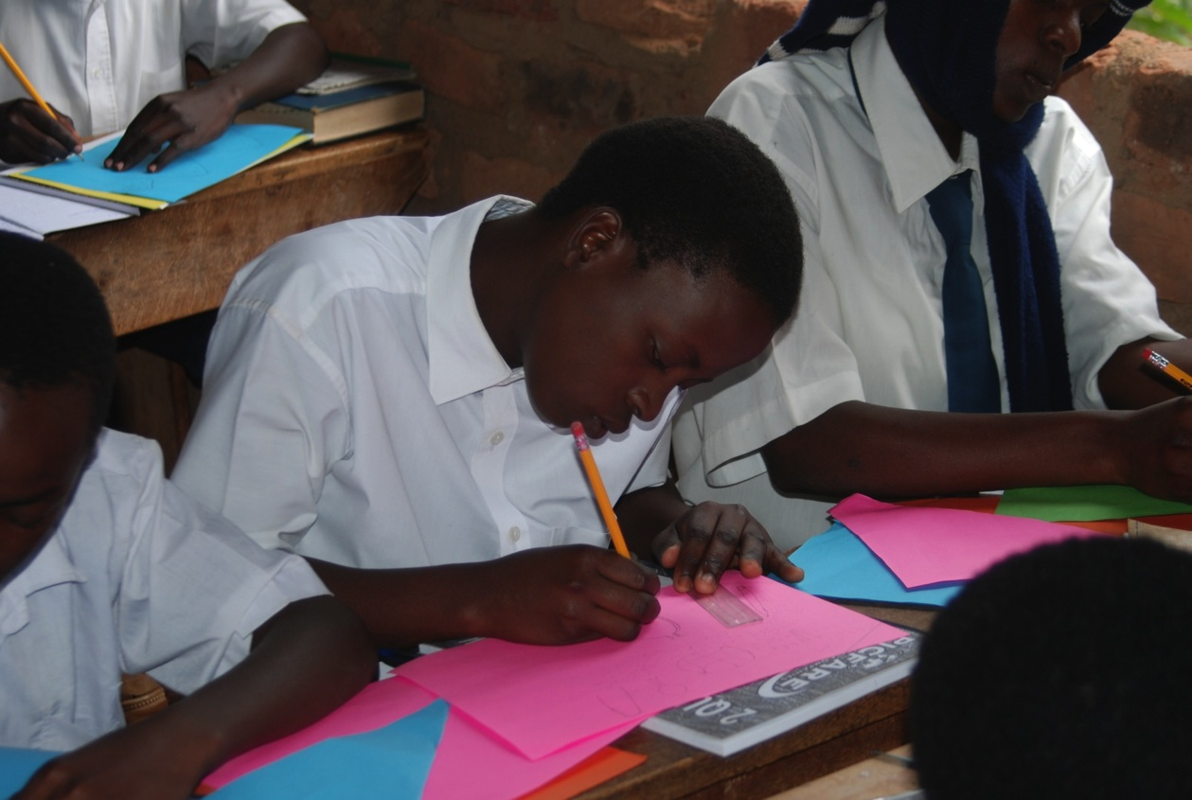
er
Brenda, a sponsored student and orphan from the
war-affected north, works to create her first Writer’s
Notebook in a class led by a visiting volunteer.

Slide 23
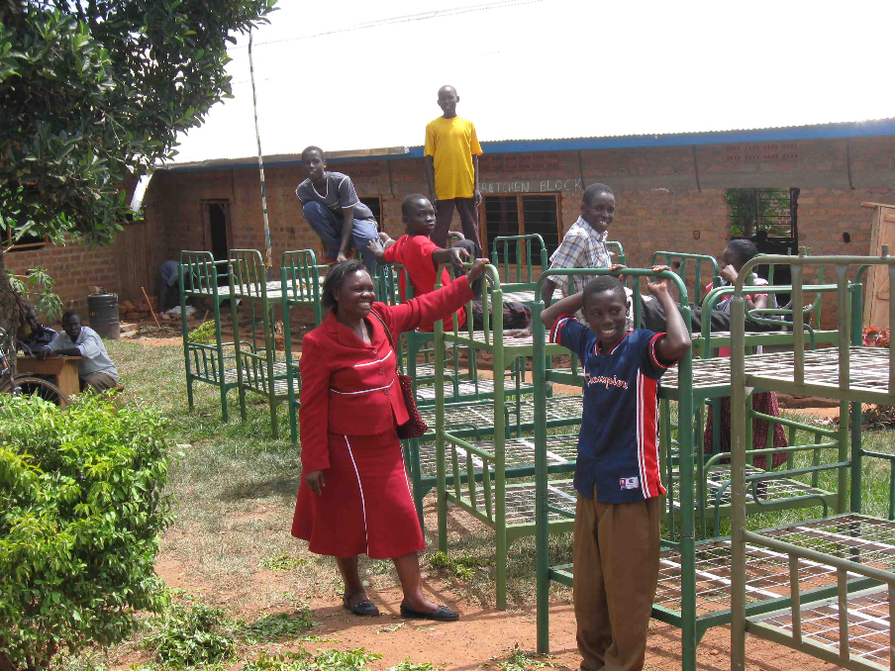
Awegys students and Alice receive beds
for the dorm donated by a U.S. high school student.

Slide 24
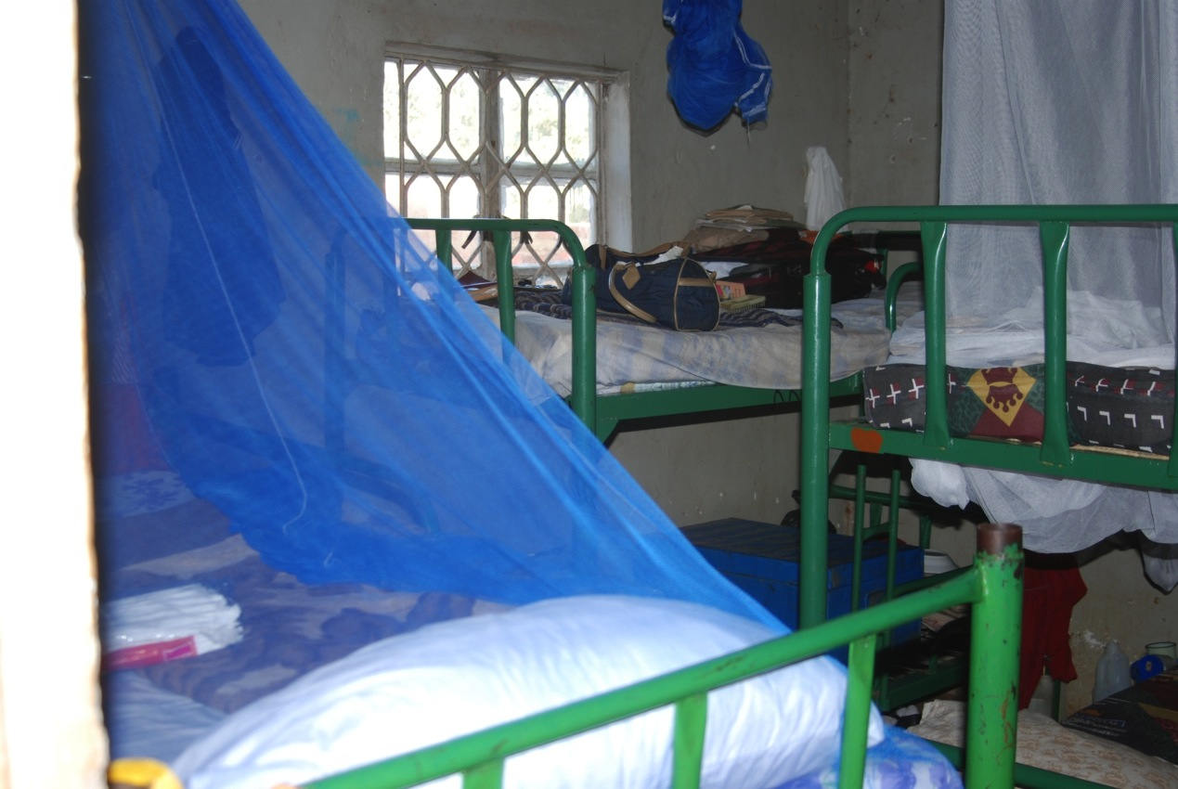
The girls’ dormitory with the donated beds
and mosquito nets for all.

Slide 25
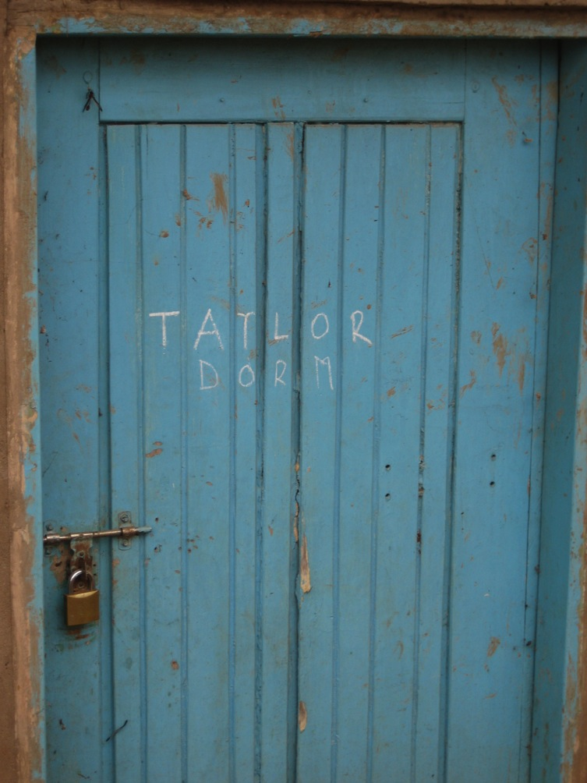
The girls of
Awegys School
named their dorm
after Taylor, the
U.S. high school
sophomore who
raised money for
the beds.

Slide 26
Although…

Slide 27
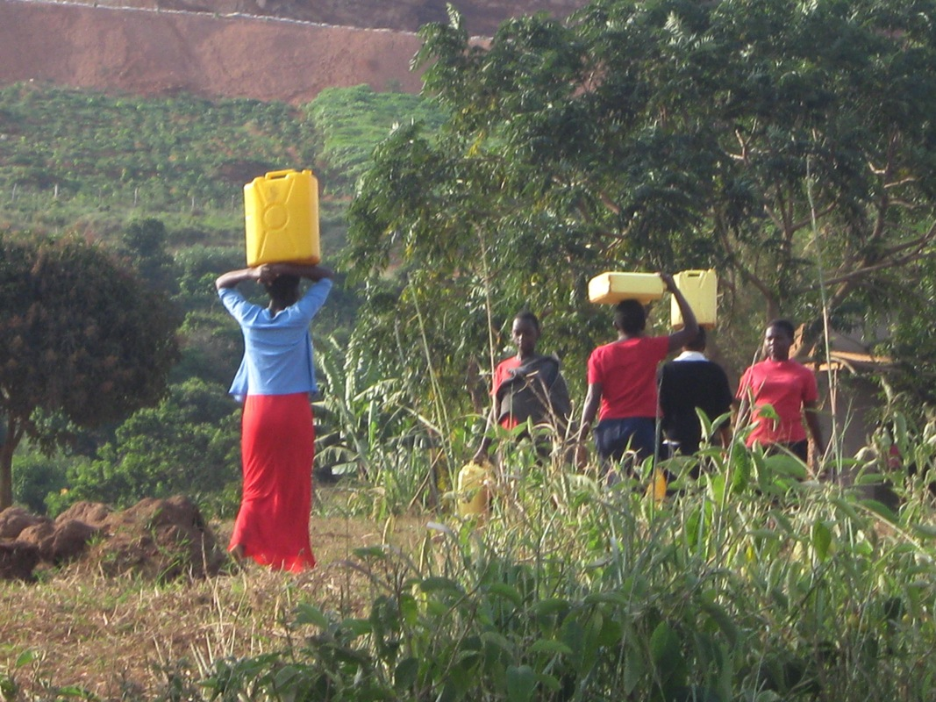
…students had begun attending school,
the school needed a well.

Slide 28
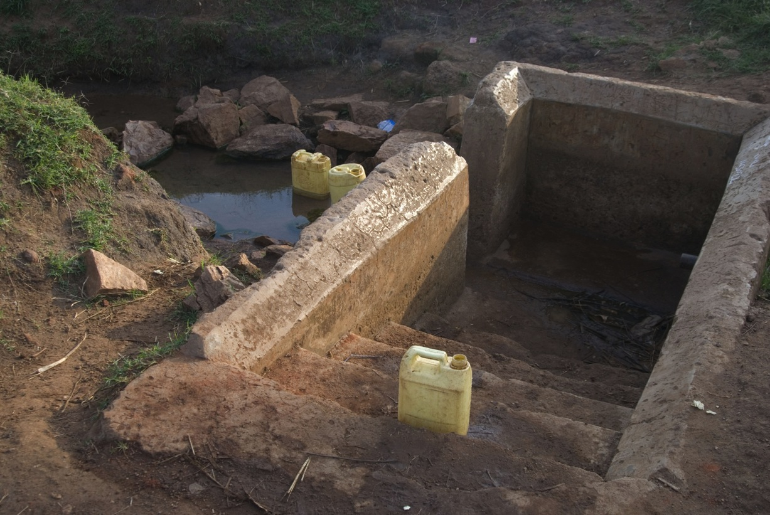
Our students and the local children
were walking one half hour each way to fetch water from this polluted stream.

Slide 29
So…

Slide 30
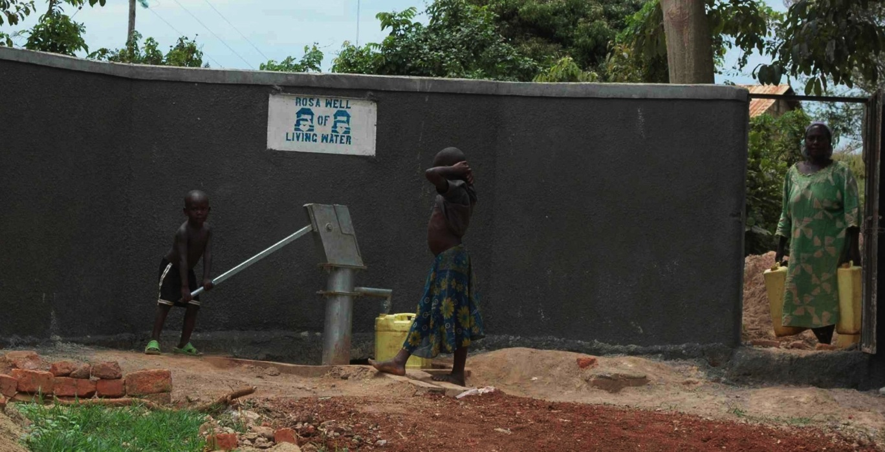
…Mtaala’s first major improvement
was to install a well that supplies clean water
to the school and surrounding village.

Slide 31
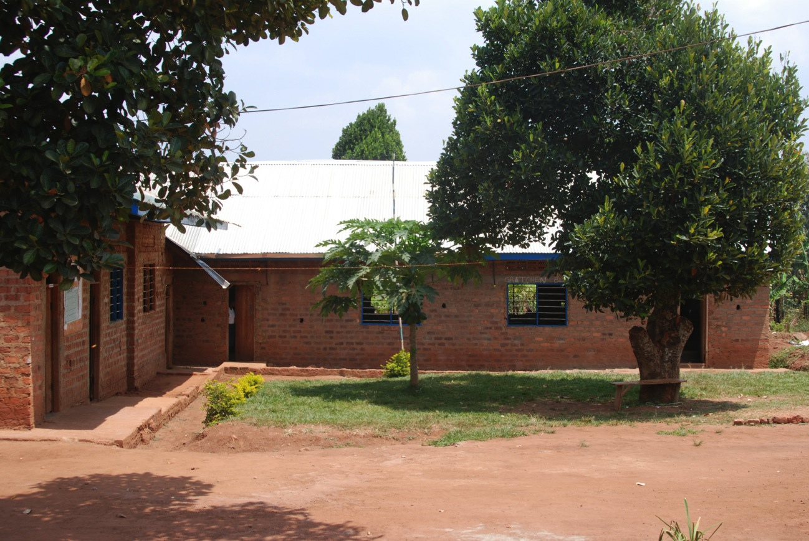
Meanwhile, work on the school buildings continued.
Windows were framed and bushes planted,

Slide 32
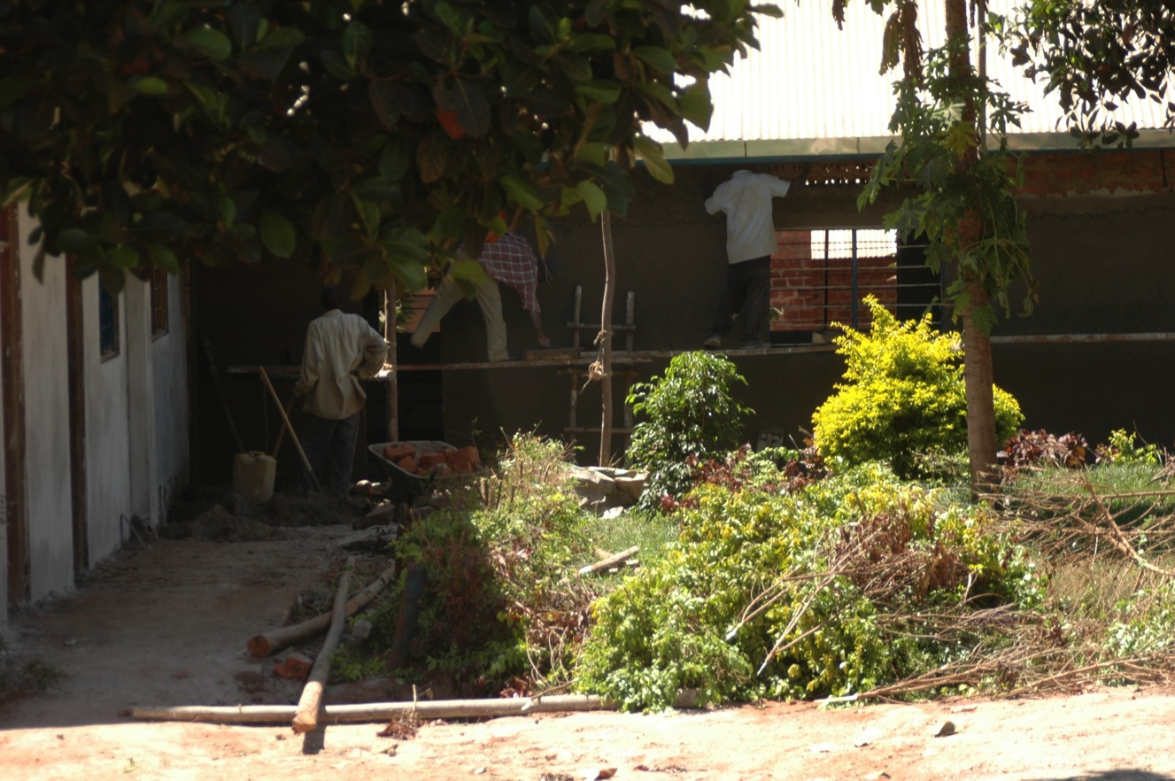
and plastering of the classroom blocks
was underway—thanks to a Mtaala donor.

Slide 33
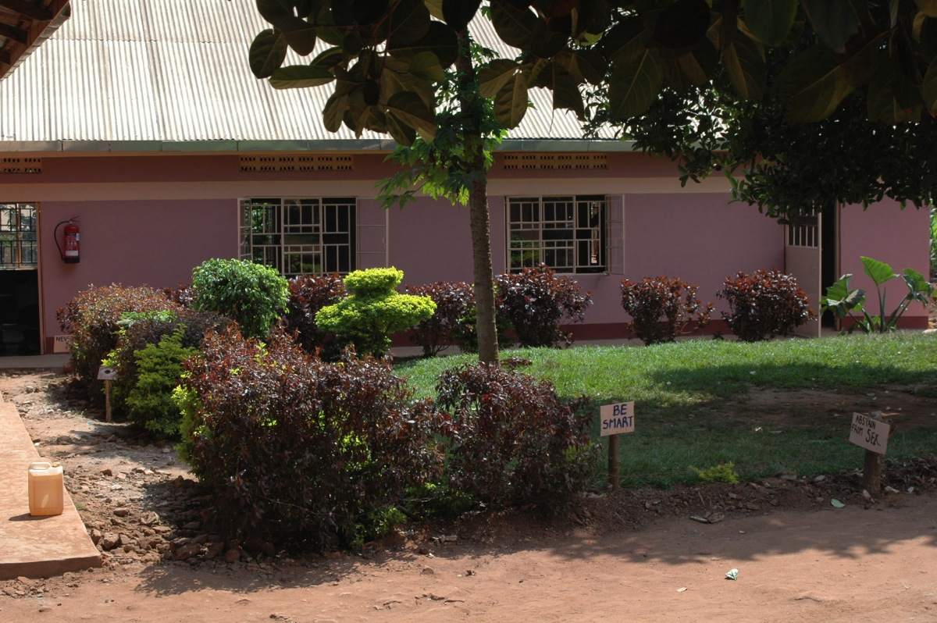
The original classroom block was finished the summer
of 2011. It has come a long way from when
students moved bricks for this building years ago.

Slide 34
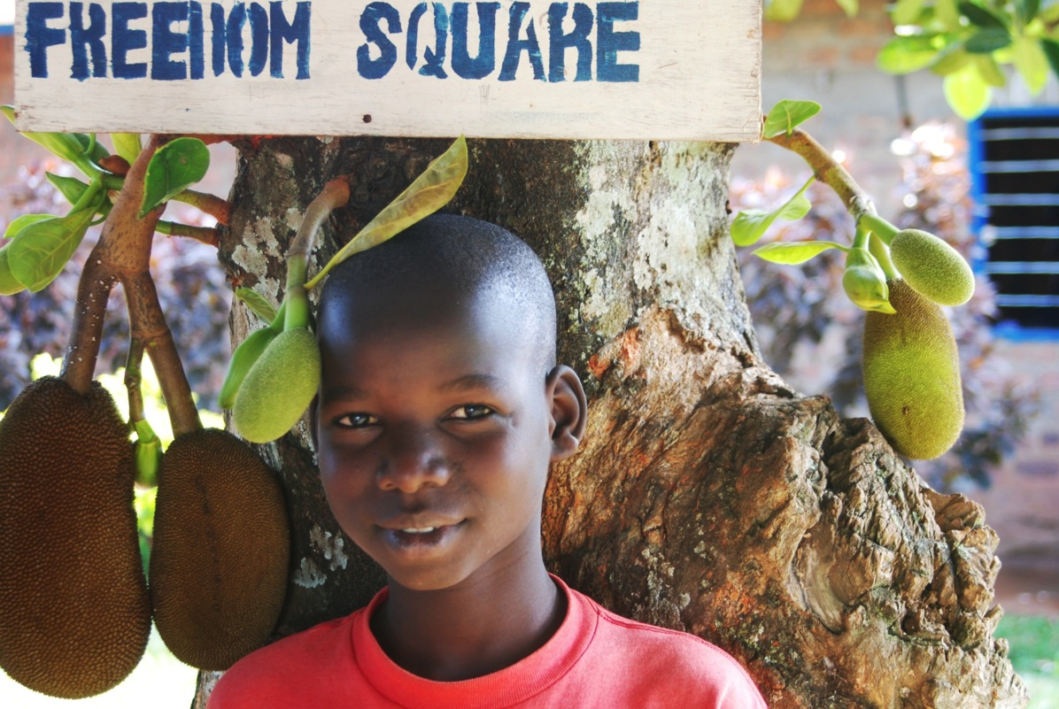
Geoffrey, a sponsored Awegys student, stands in the
student-named Freedom Square, the school’s courtyard
and place the students say they feel they can be free.

Slide 35
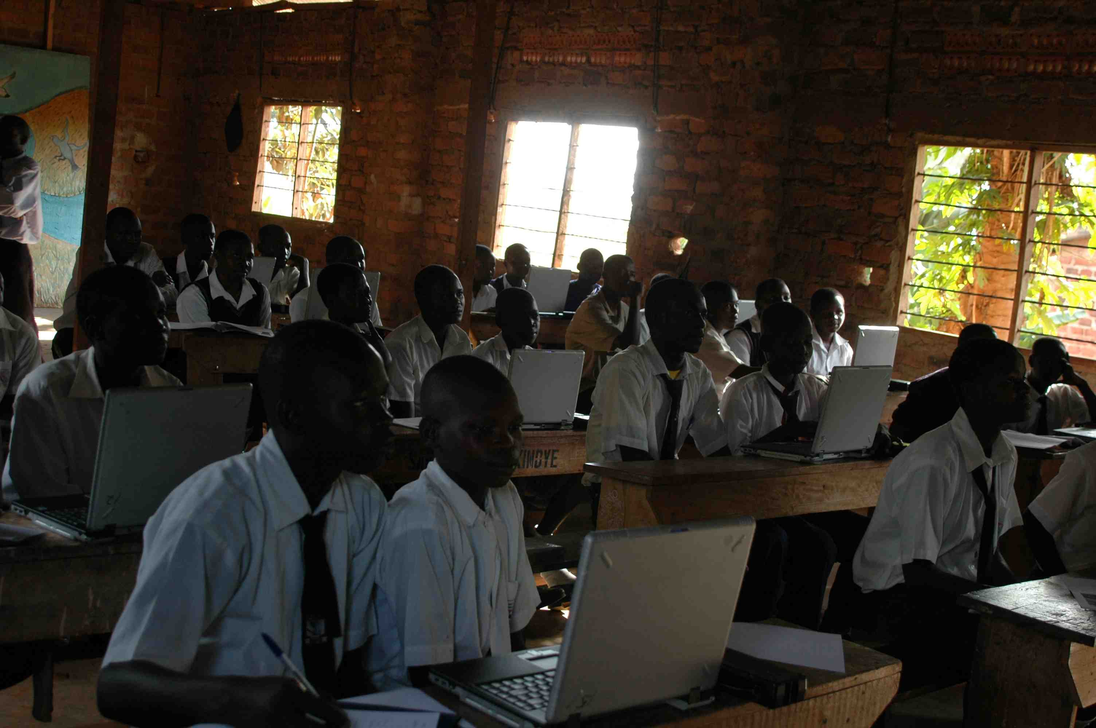
A U.S. volunteer leads Awegys students
in their first-ever computer lesson using computers
donated by Earth Walk, U.S.A.

Slide 36
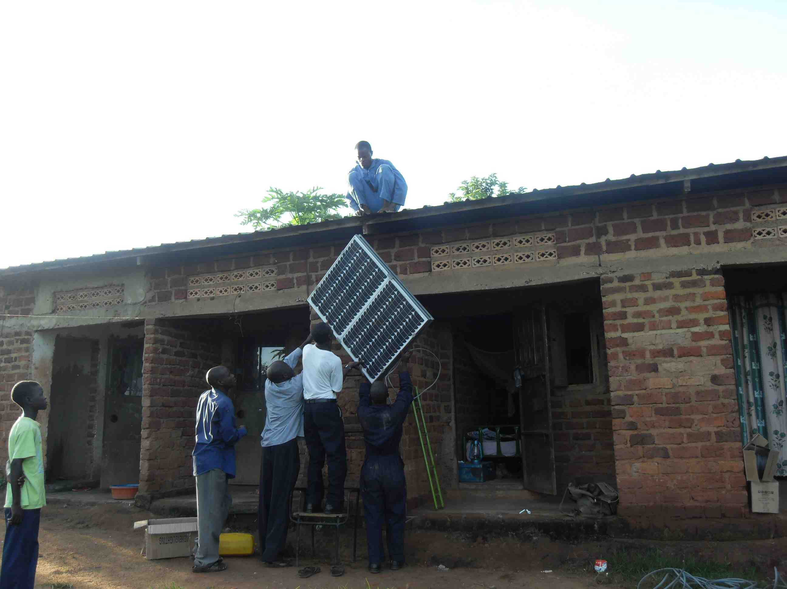
The boys’ dormitory gets solar power—
that means one light bulb in every dorm room now!

Slide 37
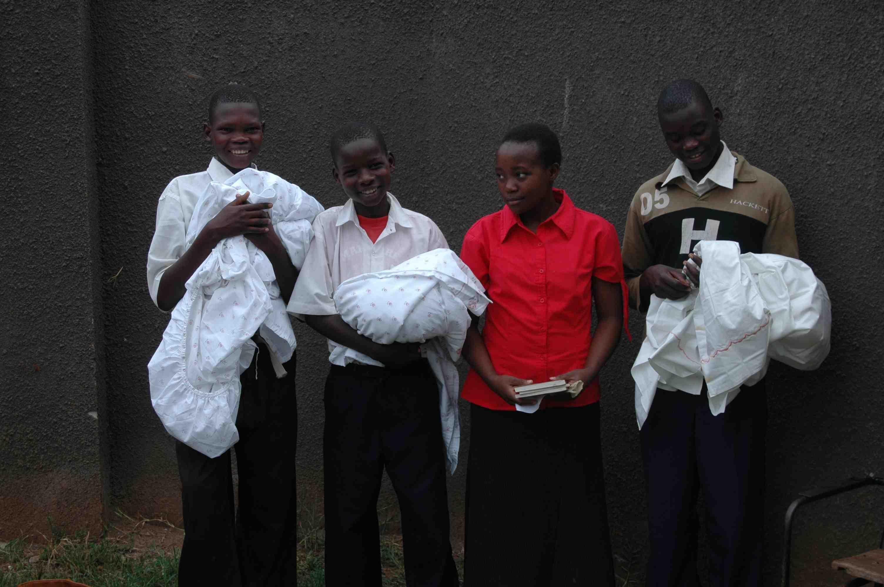
A Mtaala donor sent Awegys
students bed linens and books.

Slide 38
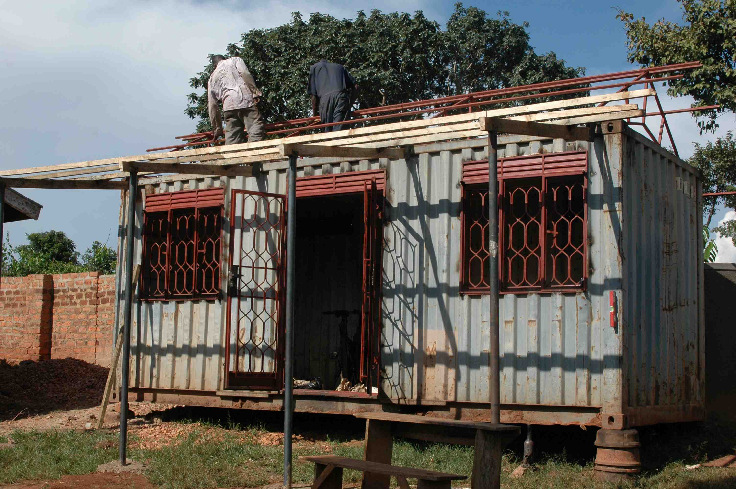
Libraries are rare in Uganda, so in 2010 Mtaala
constructed a school library out of a shipping container.

Slide 39
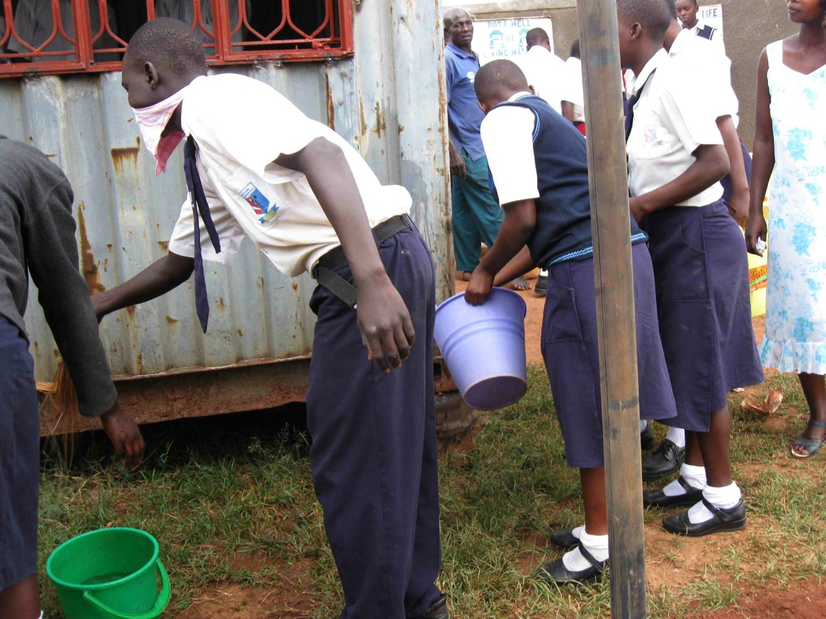
Once the library container was ready,
the students organized a cleaning.

Slide 40
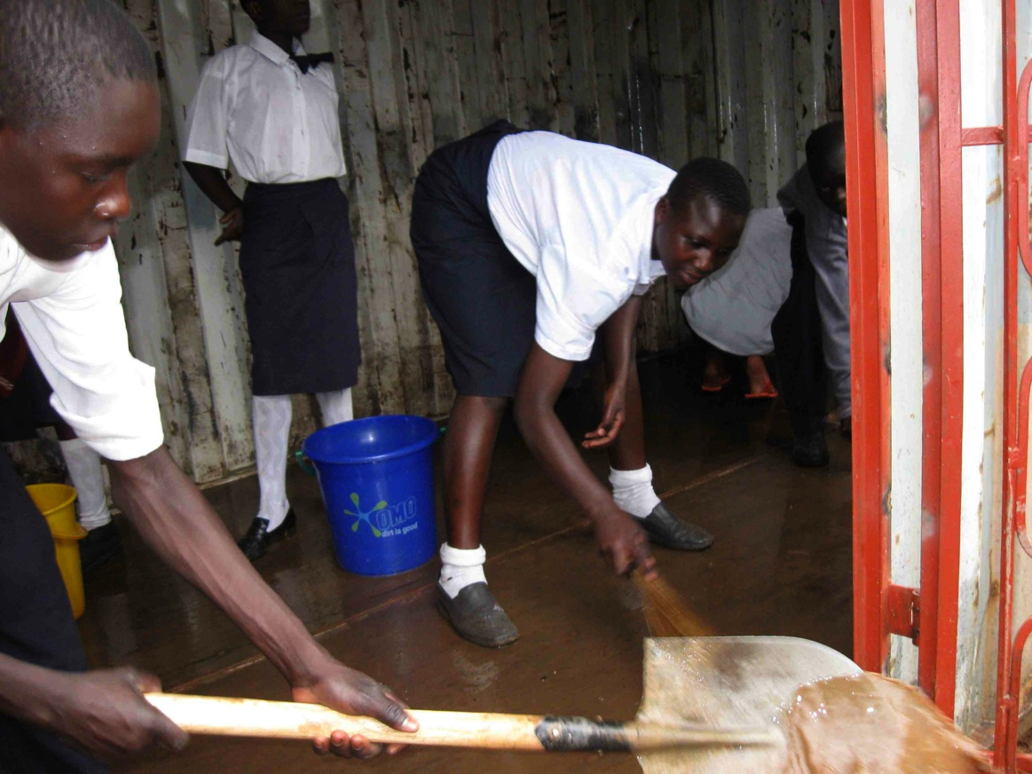
The students scrubbed the library
container to prepare it for painting.

Slide 41
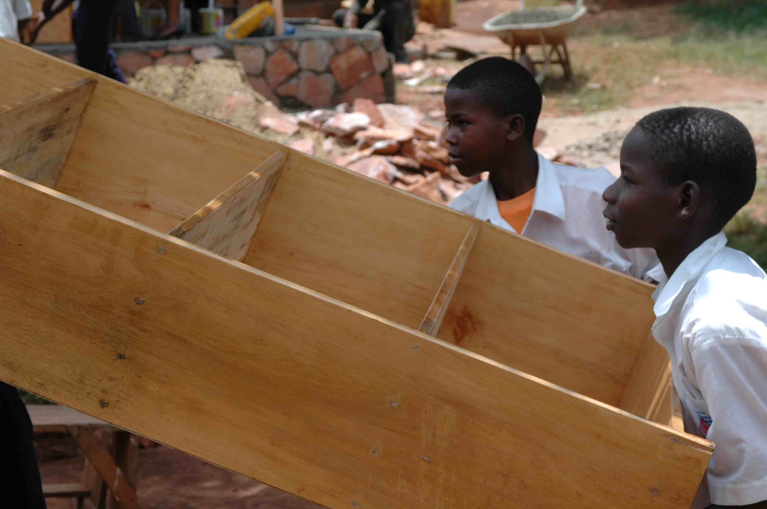
Students unload shelves for the new library.

Slide 42
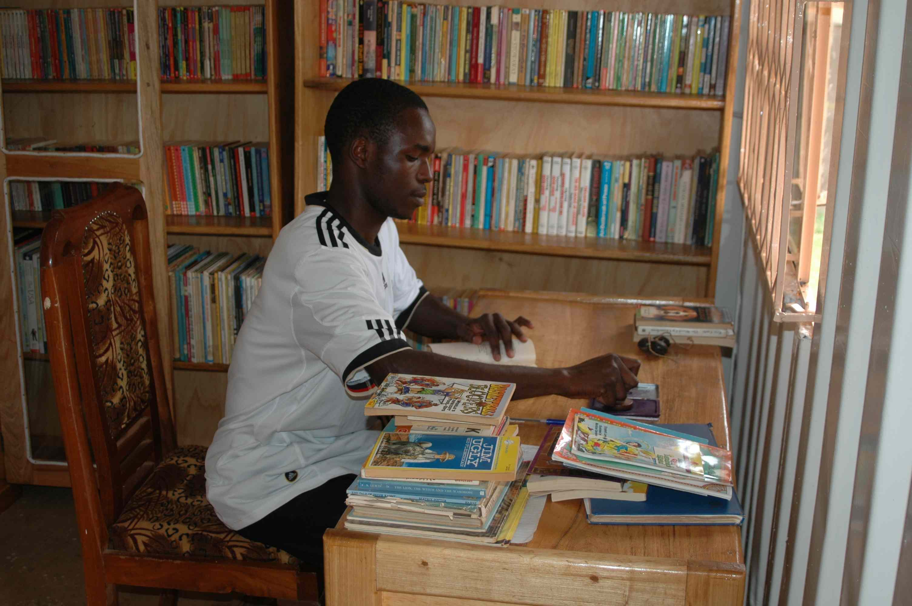
Jimmy, now a student and leader at Awegys,
stamps books in the school’s new library.

Slide 43
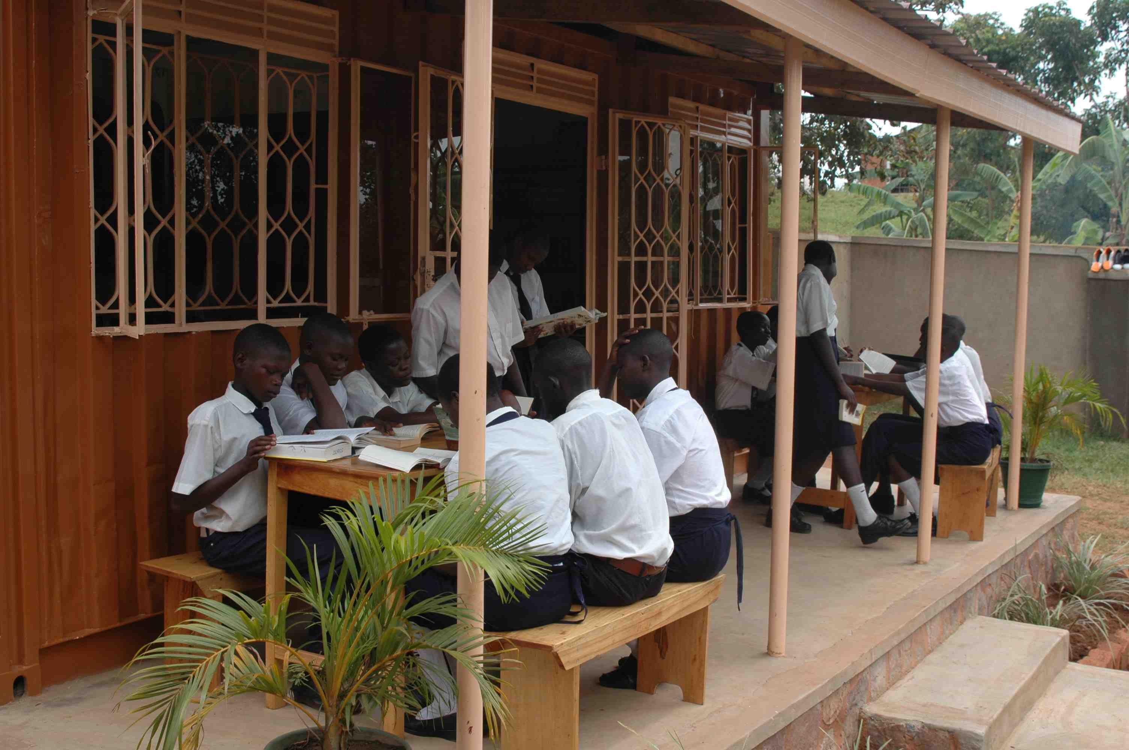
Awegys students read on the veranda
of the new library they named…

Slide 44
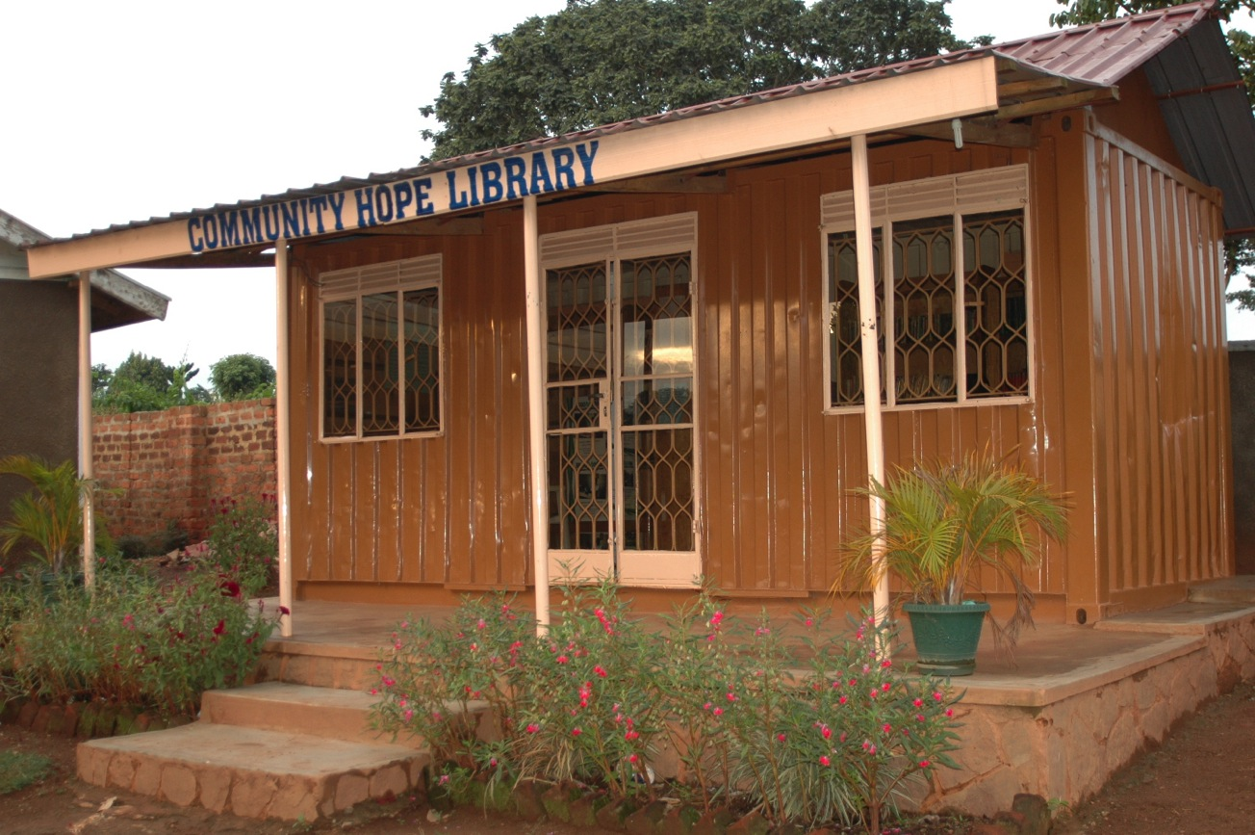
…“Community Hope Library.”

Slide 45
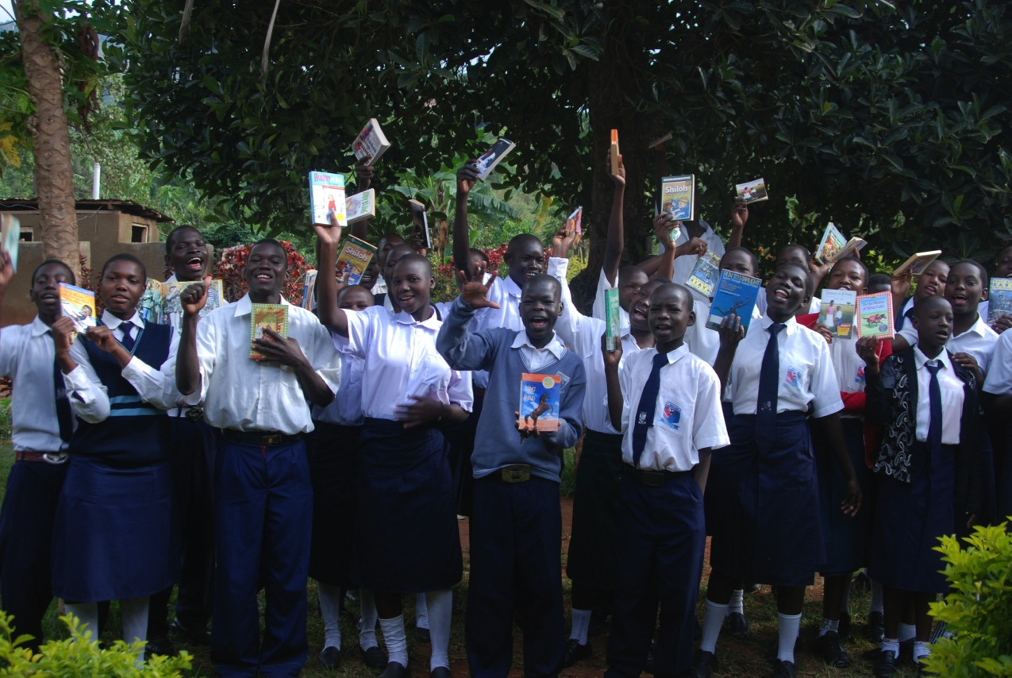
Students send a big thank you for the donated books and their new library.

Slide 46
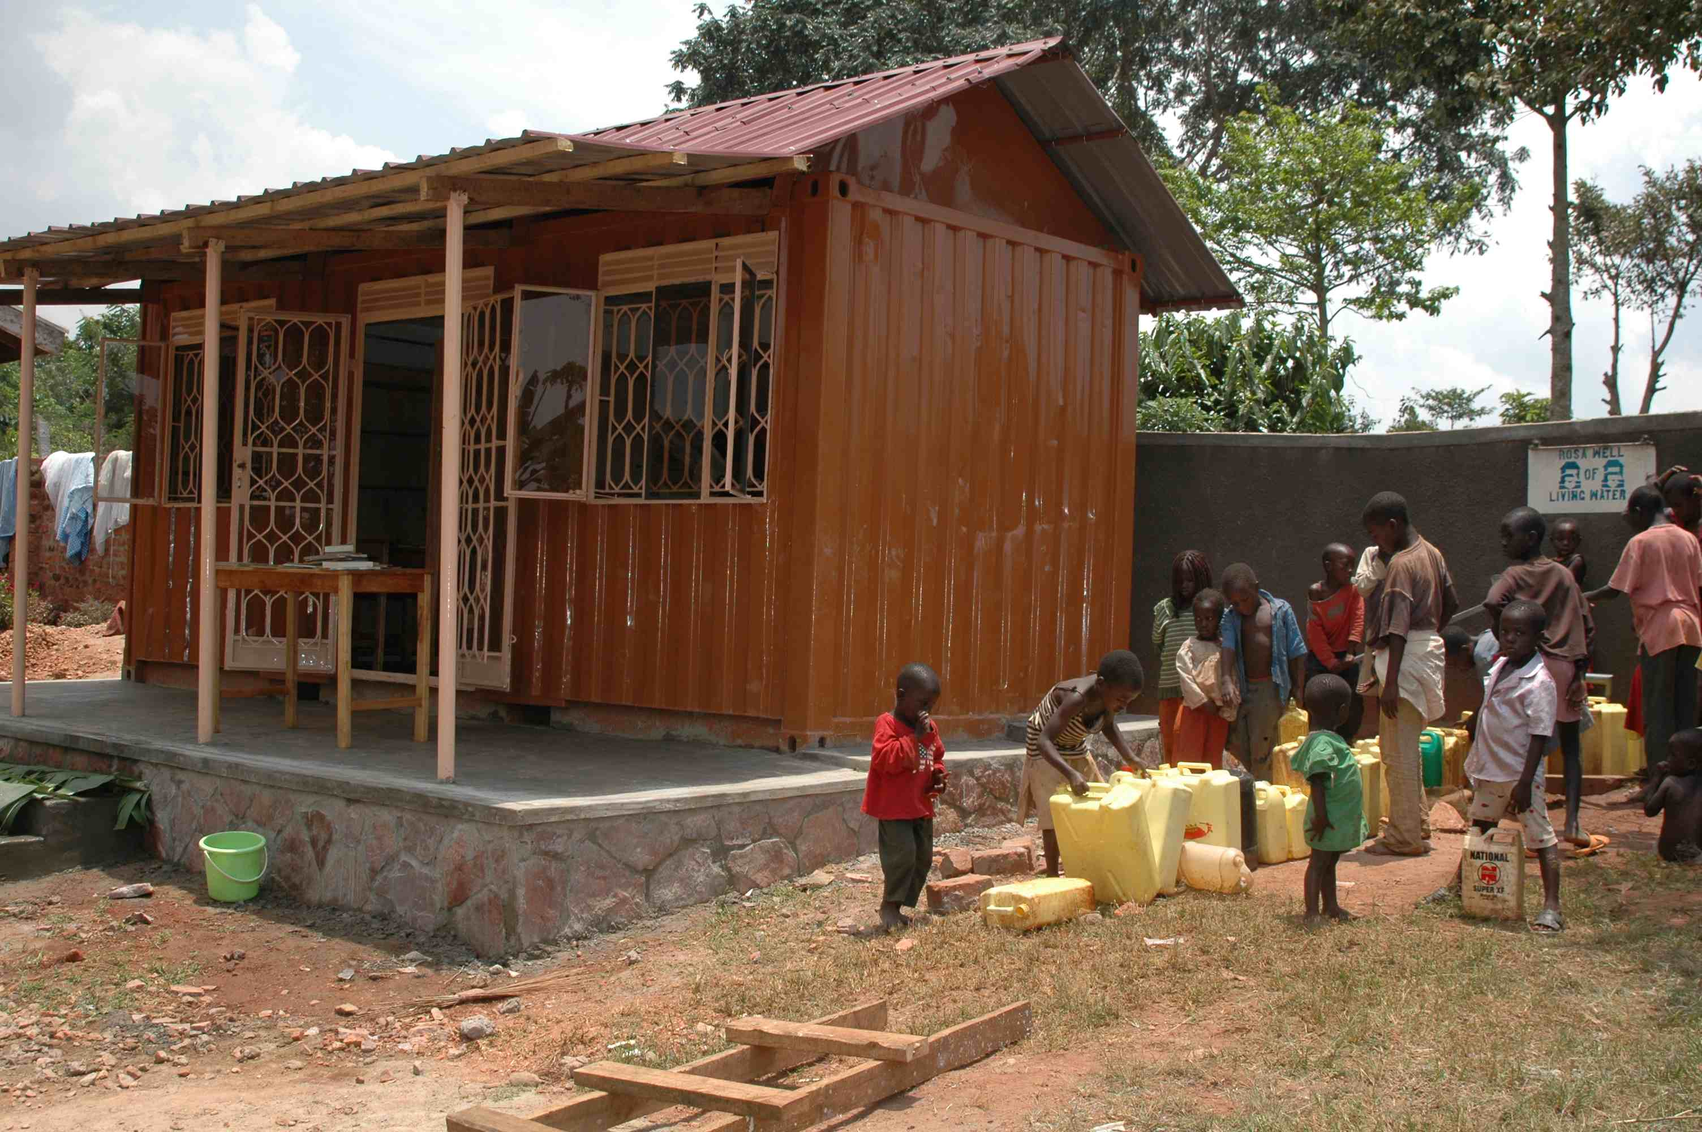
The library stands next to the well.
Both nourish the school and the village.

Slide 47
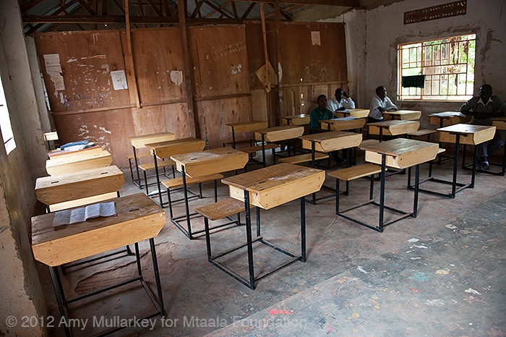
By 2012, Mtaala purchased desks,
thanks to a U.S. educational partner.

Slide 48
But—

Slide 49
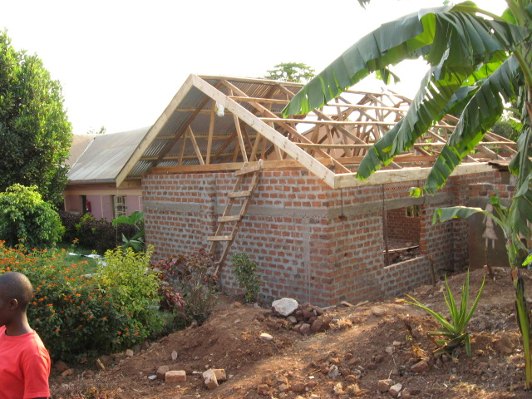
--in order to provide a comprehensive six year curriculum,
the school needed a science lab. Mtaala funded
the new lab and construction began in 2012.

Slide 50
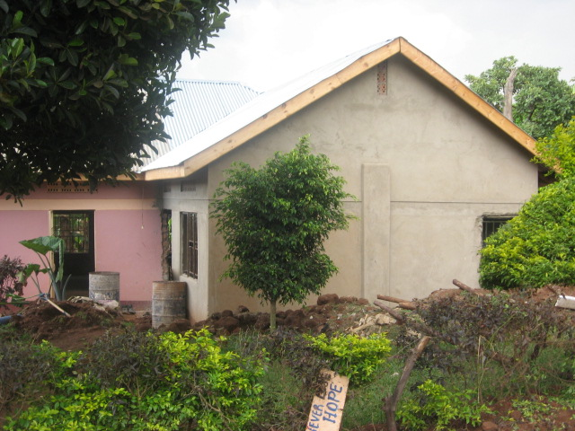
The exterior of the lab is finished, and the entire lab is attached to the original classroom block.

Slide 51
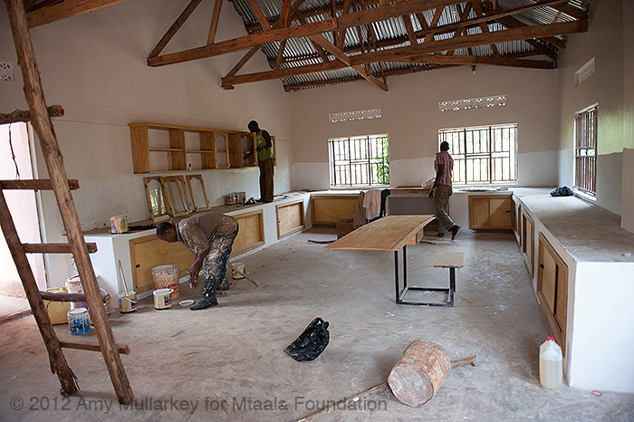
Workers outfit the inside of the lab.

Slide 52
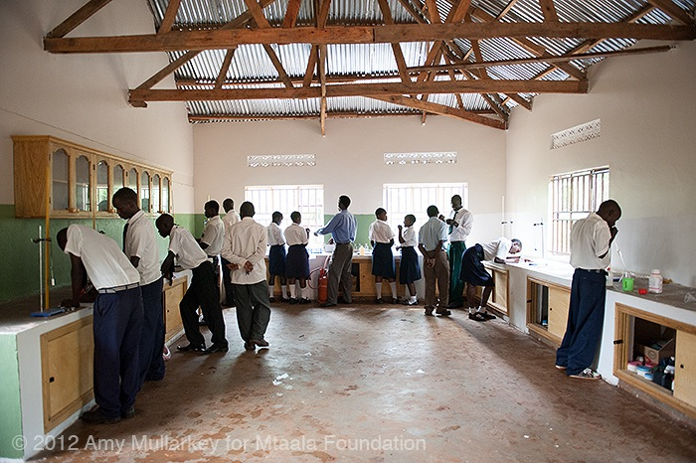
Students attend their first science class in the new laboratory!

Slide 53
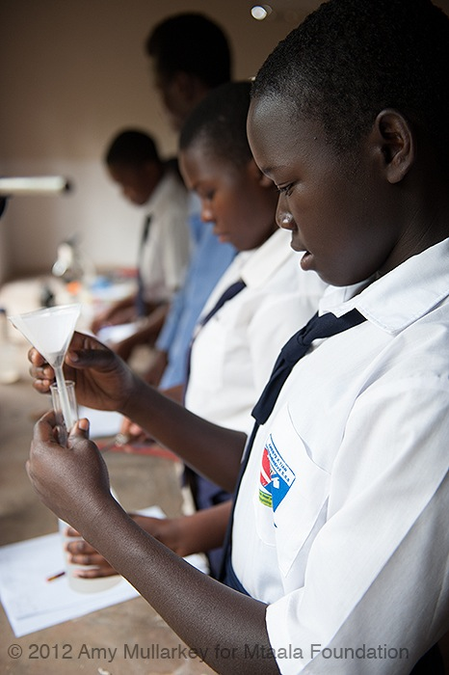
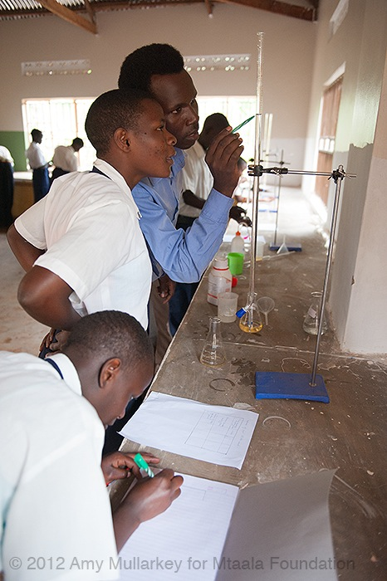
Students perform labs with equipment donated through our Educational Partnership program.

Slide 54
Next…

Slide 55
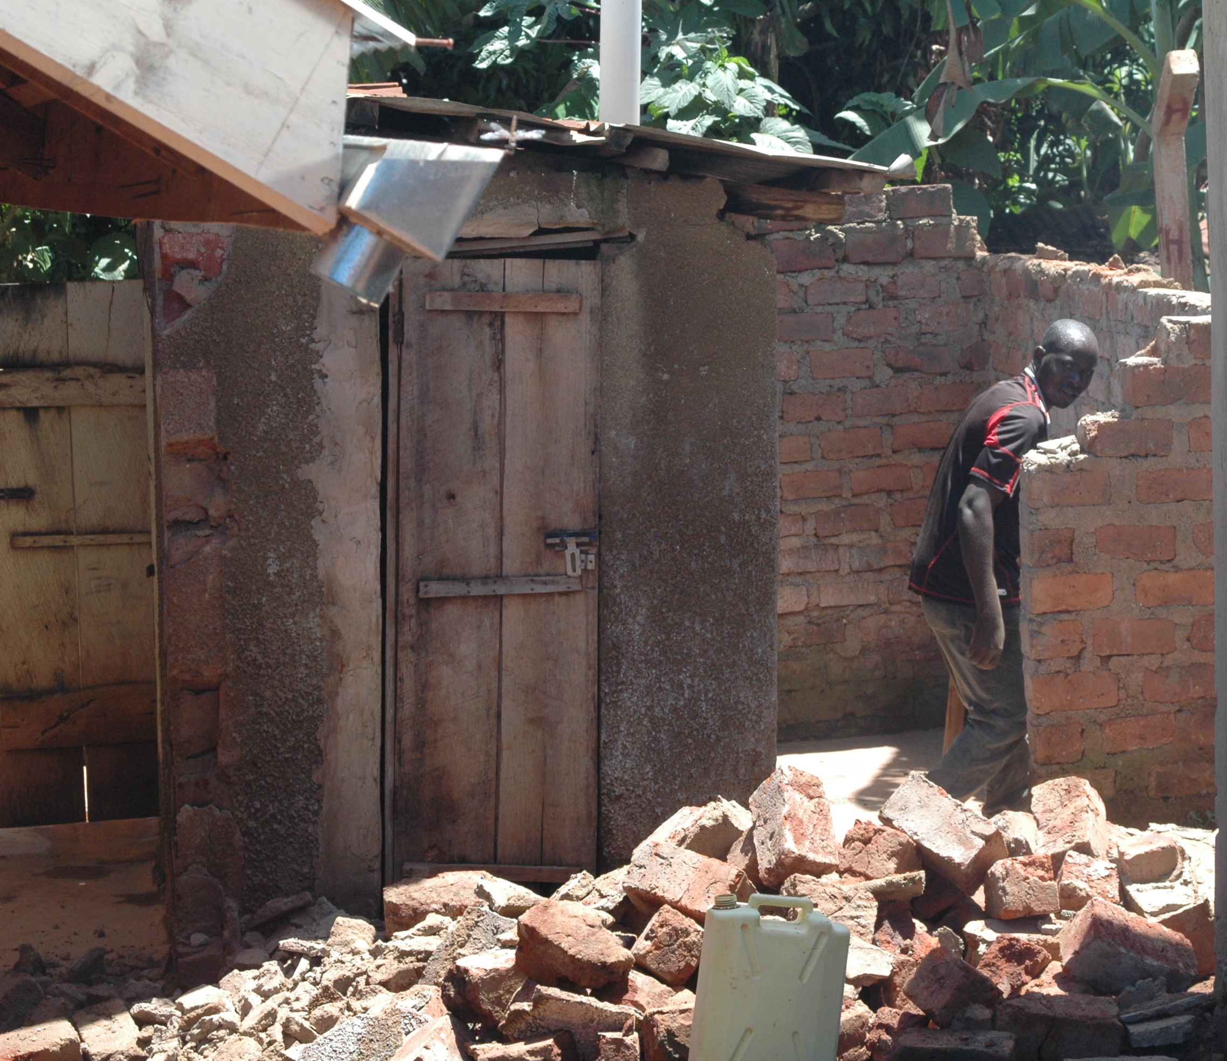
Construction for the new bathroom begins around the school’s original pit latrine.

Slide 56
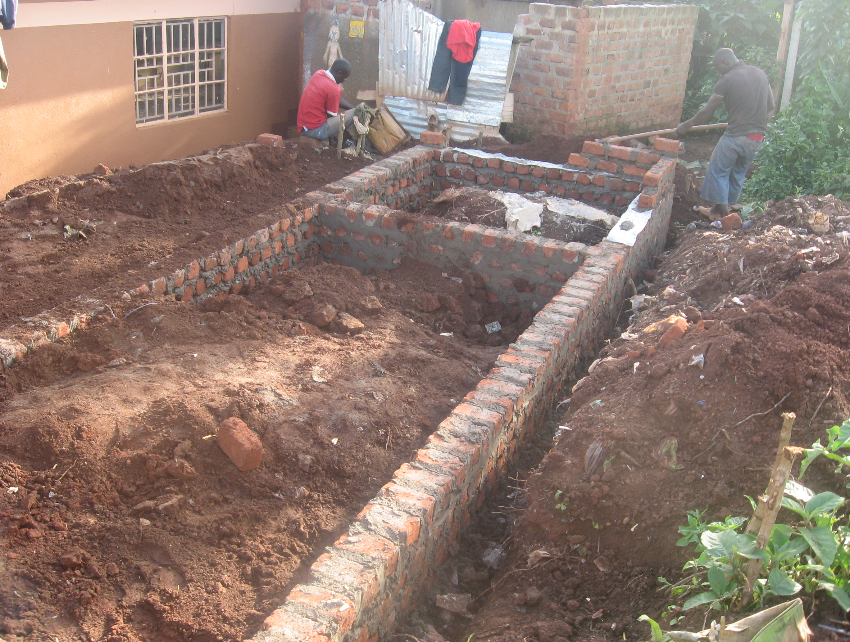
The foundation for the bathroom rises.

Slide 57
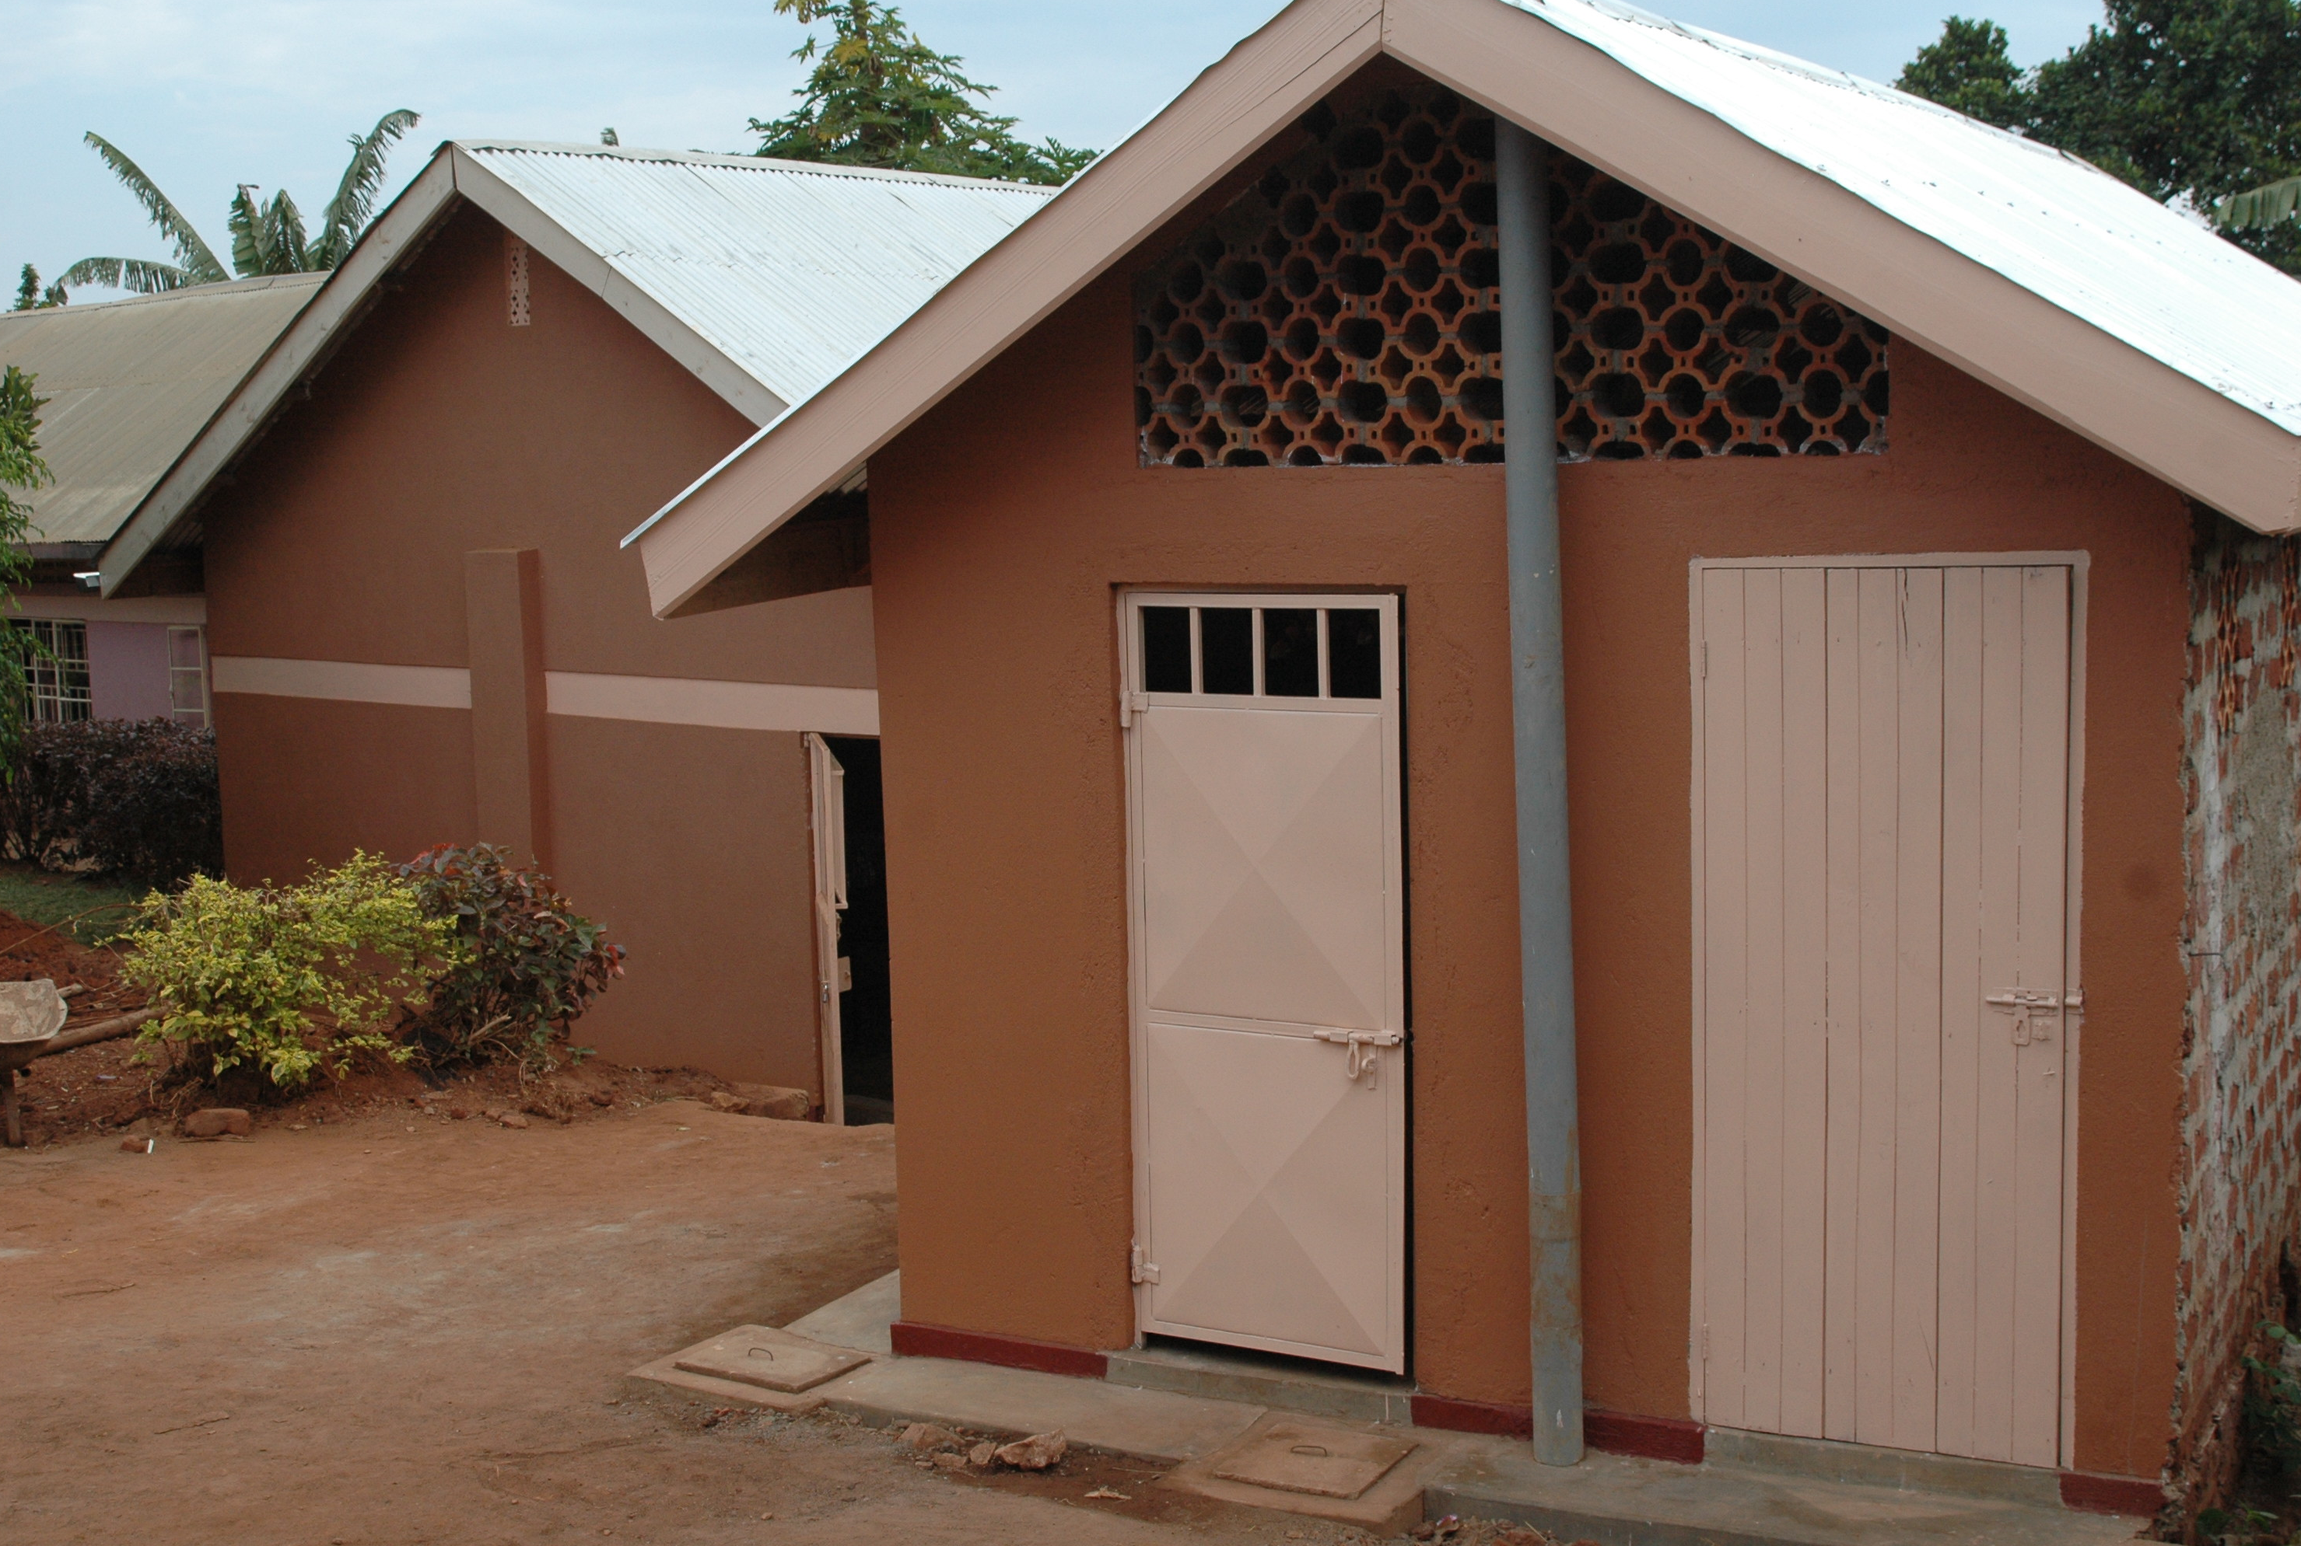
The new boys’ and girls’ bathrooms
provide a healthy and hygienic place for students to take basin baths…

Slide 58
using water they pump from the well!

Slide 59
Students manually pump
the water up to the cistern.

Slide 60
Since the cistern sits higher than the bathrooms, the force of gravity moves water from the cistern…

Slide 61
…to the sinks and toilets when needed.

Slide 62
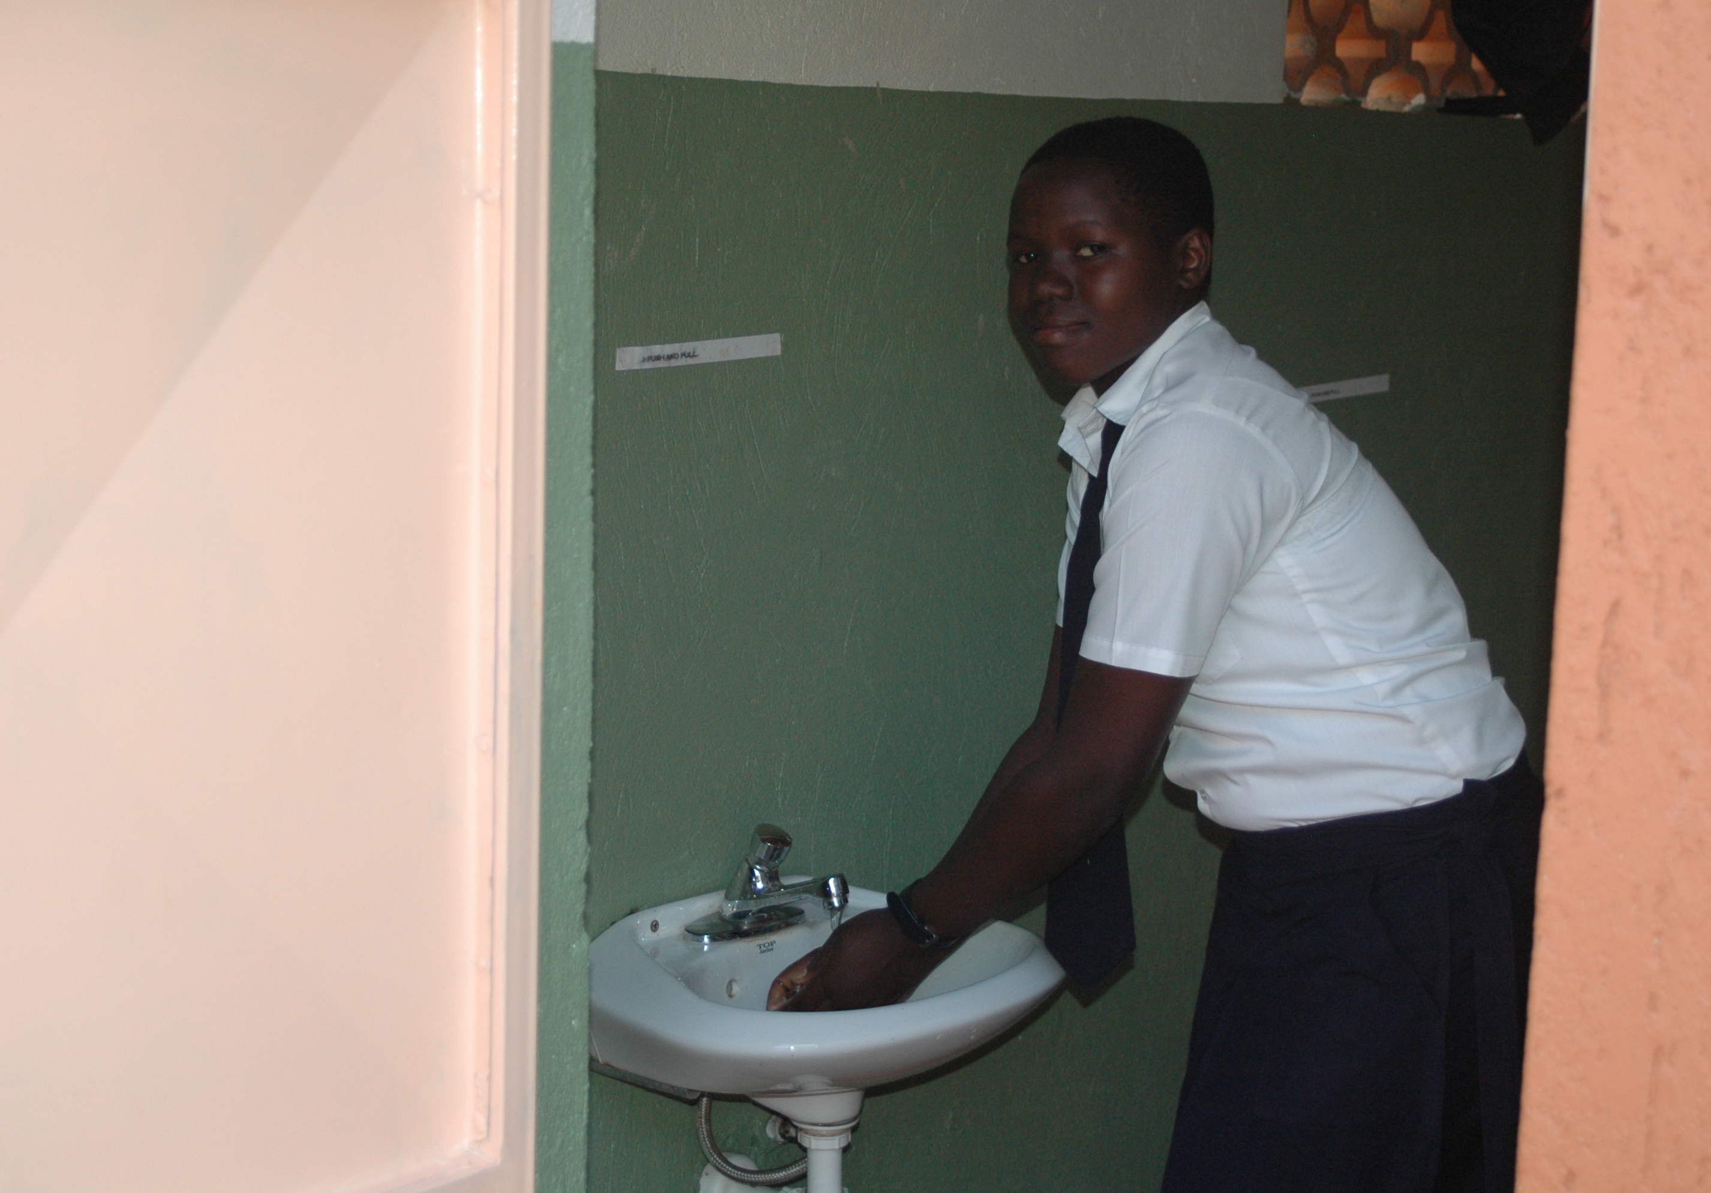
Now all students can wash their hands in a sink with soap and running water.

Slide 63
So…
Still, there was no health clinic
at the school or in the area,

Slide 64
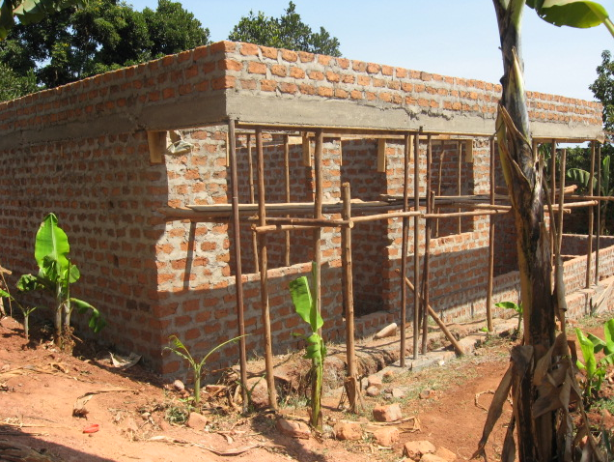
…Mtaala started constructing a community health clinic in 2013.

Slide 65
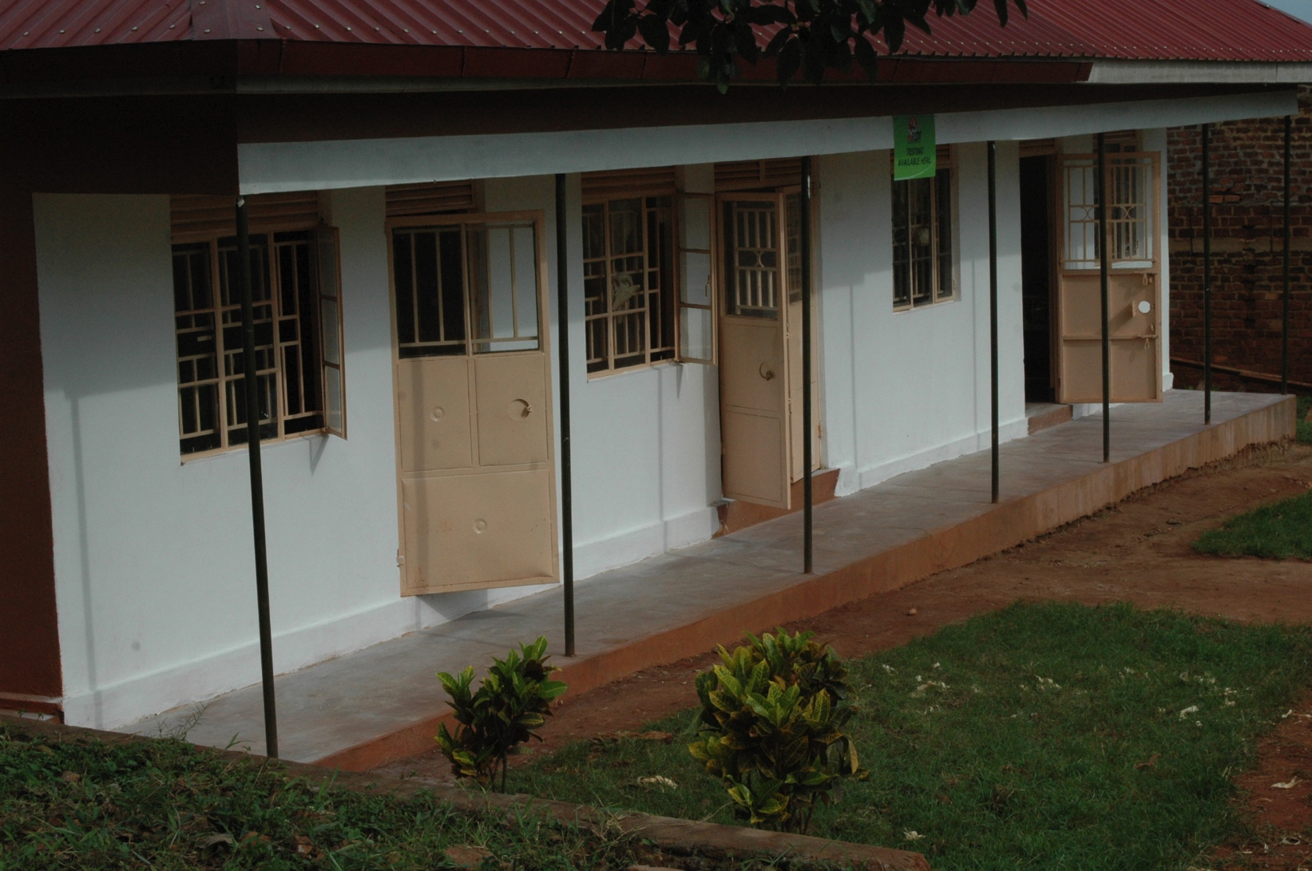
In 2014, the Thomas Fest
Community Health Clinic opened.

Slide 66

The clinic’s lobby.

Slide 67

One of the rooms for patients.

Slide 68

And pharmacy.

Slide 69

Village children participate
in a Community Health Day offering
deworming, wound care, and Vitamin A treatment.

Slide 70

A dentist visits the Fest Community
Health Clinic monthly.

Slide 71

A woman was admitted to the health clinic
with severe Malaria for two days.

Slide 72

An Awegys student receives an eye exam.

Slide 73

Students and villagers express their
gratitude in front of the completed clinic.

Slide 74

Big news! Demolition begins…

Slide 75

on Alice’s original house…

Slide 76

for a new classroom block and dorm.

Slide 77

Students attend school during construction.

Slide 78

The new classroom building continues to rise.

Slide 79
In response to the learning
and support our students receive,
every Saturday our students
“Pay It Forward.”

Slide 80

They cross the road from the school
and gather local children
for Community Reading Day.

Slide 81

Under the “Reading Tree,”
Awegys students prepare for Community Reading Day.

Slide 82

Awegys students sing and dance with the village
children at weekly Community Reading Day.

Slide 83

They sit with the children
and read books donated by Mtaala.

Slide 84

Our students teach the children vocabulary, English, and songs and finger games…

Slide 85

…and share a lot of laughter and smiles.

Slide 86

They spread the joy of books,
reading, and learning.

Slide 87

Our students also run an environmental group.
Here, they clean up litter while educating people
about local environmental issues.

Slide 88

Special workshops include a visit from an American
playwright and film maker. She helped students write
and perform an original musical about their lives.

Slide 89

The students perform a scene about their lives in the war-affected North.

Slide 90

Students perform their finale,
“Victory in Education.”

Slide 91

After enjoying the play, all the village children
were invited to celebrate with lunch and cake.

Slide 92

A local artist also teaches our students how to paint on bark cloth, an ancient cultural art form. Paintings may be purchased through our website.

Slide 93

Young children gather at the school
for a girls’ leadership workshop.

Slide 94
Although Awegys is a secondary school,
it has become a magnet for children
of all ages in Kigo village.

Slide 95
Working together with local Ugandans, we hope to continue to improve
the children’s future…
build a multi-storied building for additional classrooms and dorms,
as we raise funds to provide solar power and a generator
for the clinic,
while continuing to sponsor the most vulnerable children’s education.
fund a medical staff
for the clinic,

Slide 96
Mtaala’s goal is to make
Awegys Secondary School
self-sustaining.
Please join us.

Slide 97

In the meantime,
thank you for
providing
the children with
time to learn
and dance.
***
Awegys students perform
a traditional dance
for visitors.

Slide 98
For more information visit www.mtaala.org or call Gretchen at
609-932-8207

